Slide 1
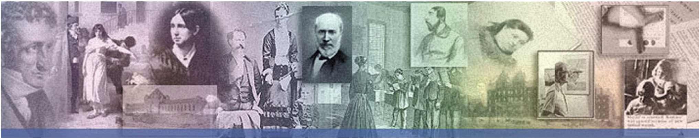



I Didn’t Mean Anything By It
Microaggressions Toward People With Disabilities
Notes:
How to recognize everyday verbal, nonverbal, and environmental slights, whether intentional or not, which communicate hostile, derogatory or negative messages to persons with disabilities and how subtle remarks, actions, and even intended compliments, can often be just as harmful as outright discrimination and ableism.

Slide 2
What is a MICROAGGRESSION?
Verbal, nonverbal, and environmental slights, whether intentional or not, which communicate hostile, derogatory or negative messages to a person
Subtle remarks and actions, and even intended compliments, which can often be just as harmful as outright discrimination and ableism

Slide 3
EXAMPLES of MICROAGGRESSIONS
Believing that you somehow know more about the person’s disability than they do
Have you tried ?
I know someone that has the same thing as you, and worked for them.
Having a positive attitude can help you get through it.

Slide 4
EXAMPLES of MICROAGGRESSIONS
Patronizing the person with a disability
You are so brave. You’re such an inspiration.
I wish I was as strong a person as you are.
I don’t know how you go on, I don’t think I could do it.
God has a plan for you. There is a special place in Heaven for you.
You dress so nicely, who helps you buy your clothes?
How wonderful that you were able to all by yourself.
You would never know that you were disabled. You seem so normal.

Slide 5
EXAMPLES of MICROAGGRESSIONS
Making assumptions about a person’s disability
Assuming that because someone is in a wheelchair that they cannot walk, or have no feeling in their legs.
Assuming a person with a disability can’t drive, can’t work, can’t dress themselves, etc.
Assuming that a person who uses sign language is deaf.
Assuming a deaf person cannot speak.
Assuming a person that cannot speak does not understand language.
Assuming a physical disability = an intellectual disability.
Assuming an intellectual disability = an inability to learn.
Assuming the person without a disability they’re with is a care giver or family member instead of a friend or romantic partner
Assuming people with disabilities are ashamed of their disability
Assuming that people with disabilities are envious of people who are not disabled
Assuming that someone with a disability is not PROUD of everything about who they are.

Slide 6
EXAMPLES of MICROAGGRESSIONS
Asking personal questions you wouldn’t ask anyone else
Can I ask you a personal question?
What happened to you? How did you get like this?
How do you ?
Can you ?
What if ?

Slide 7
EXAMPLES of MICROAGGRESSIONS
Avoiding a person with a disability
Avoid looking at a person with a disability
Awkward? Afraid of getting caught looking?
Avoid offering to help a person with a disability
Afraid might offend the person by offering to help?
Avoid talking to a person with a disability
Afraid to say the wrong thing? Panic about how to say something?
Notes:
While there may be people who are repelled by a person’s disability, most people that avoid eye contact because feel awkward, are uncomfortable with the subject of disabilities or believe they are somehow being disrespectful.
There is a difference between looking or making eye contact and staring uncomfortably.

Slide 8
EXAMPLES of MICROAGGRESSIONS
Touching a person with a disability in ways you wouldn’t touch anyone else
Grab a person by the arm to guide them
Pat them on the head, back, shoulder, etc.
Push their wheelchair for them
Lift them up to reach something
Hold their hand while crossing the street, walking on stairs, etc.

Slide 9
EXAMPLES of MICROAGGRESSIONS
Treating them as a DISABLED person, instead of as a PERSON with a disability
Talk down to them.
Talk loud and slow to them (and with fewer words)
Talk about them, around them
Assume they need help
Avoid talking about sensitive or “complicated” subjects

Slide 10
EXAMPLES of MICROAGGRESSIONS
Expecting the person with a disability to be the expert on all persons with a disability
Any person really only knows their own life, including their own experiences, values, beliefs and interests.
While a person may have a broad cultural understanding of a particular group of people, especially if they relate to that group, they are still only an individual and can speak only for themselves.

Slide 11
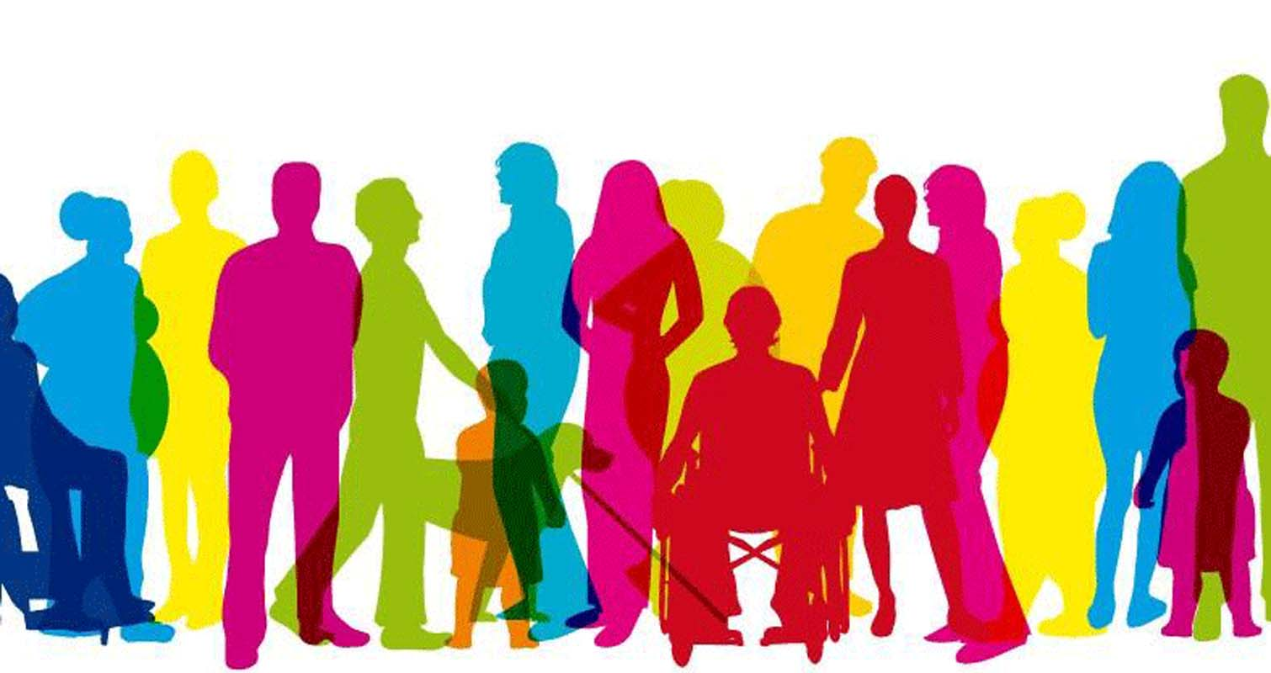
CULTURAL COMPETENCE
What Is “Cultural Competence” & What Does It Have To Do With Microaggressions?
Notes:
What Does Cultural Competence Have To Do With Microaggressions:
Before you can be sensitive to how others feel about your comments and actions, you must first have an understanding of why certain words or actions would be perceived as offensive by someone.
Cultural competence is a way examining one’s own attitudes and values, and to develop the values, knowledge, skills and attributes that will allow a person to interact appropriately in cross cultural situations. Without that competence it is easy to dismiss the reactions of others to what you consider minor or unintentional slights.

Slide 12



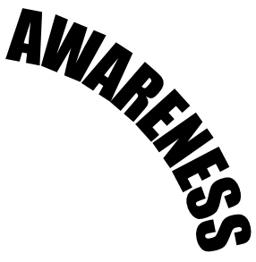




CULTURAL COMPETENCE
Notes:
Awareness: Having the capacity for self-assessment to become aware of how our own background and life experiences have molded the person we are today – including how our beliefs, values, etc. are developed.
Sensitivity: Being sensitive to the fact that the events in our lives that molded our identities affect how we respond to our environments, events in our lives, and how we interact with others with unique experiences of their own that mold their interactions and reactions.
Knowledge: Making the choice to develop knowledge about other cultures or persons from reliable sources and being open to an understanding that may be contradictory to our own long-held beliefs.
Skills: Using the knowledge of the cultural experiences of yourself and other and an understanding of the impact these have in developing relationships and respectful interactions.

Slide 13
Why Might People Struggle With Respectful Interactions With People With Disabilities?
Historically, People with disabilities were written off as being incapable of being a productive, beneficial member of society
A Broken Body = A Broken Mind
Moral Model
Feel sorry for them; Be ashamed of them; Hide them
Medical Model
Treat them; Fix them; Cure them
Rehabilitative Model
Counsel them; Correct them; “Normalization”; “All or Nothing”
Notes:
Moral Model: Historically, this is the oldest model of how people viewed a person’s disability. Some extreme versions of this associate a person’s disability with sin and shame, and often result in feelings of guilt.
Families have hidden away family members, keeping them out of school and excluded from any chance at having a meaningful role in society.
Even in less extreme circumstances, this model has resulted in general social ostracism and self-hatred as the person is seen as a burden or a moral “cross to bear.”
Medical Model: People with disabilities were seen as needing to be “fixed”
Medical professionals are the expert and any “problems” associated with the person’s disability are viewed as symptoms in need of improvement.
This model focus on care and protecting the person and ultimately provides justification for institutionalization and segregation. This restricts people’s opportunities to make choices, control their lives and develop their own, unique potential.
Rehabilitative Model: Regards the person with a disability in need of clinical services such as training, therapy, and counseling to compensate for the deficiency caused by the disability to help them to better acclimate and fit into social norms – including home environments, work environments, community, etc.
While seemingly supportive, this model still encouraged stripping a person of their identity to be “more appropriate” for whatever situation they were in. this also leads to an “All or Nothing” approach to life.

Slide 14
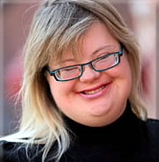
DISABILITY ETIQUETTE
It’s natural to feel awkward in unfamiliar situations, such as when interacting with someone with a disability
The purpose of any social or professional etiquette is to:
Help someone feel comfortable in any given situation
Respect a person’s dignity
Invite and encourage social or professional interaction
To avoid people feeling awkward
Notes:
You should never feel awkward when interacting with someone with a disability nor do you want to make the person feel uncomfortable.
In order to change perspectives of how to treat people with disabilities, Disability Etiquette can assist to bring back some dignity to people who have been treated poorly by society as a whole.
As with any type of etiquette (professional etiquette, social etiquette, etc.) the purpose of Disability Etiquette is to help people feel comfortable in any given situation, respect a person’s dignity and encourage social and/or professional interactions.

Slide 15
DISABILITY ETIQUETTE
NATURAL LANGUAGE
A person’s disability is a part of who they are and shouldn’t be ignored
But it should not be the primary focus of defining them
Someone wheelchair bound
Disabled people
A paraplegic
An person capable of ambulation
A person who suffers from epilepsy
A non-verbal person
An autistic
Living in a less-restrictive environment
A normal person
A runner
A high-functioning individual
Behavioral

Slide 16
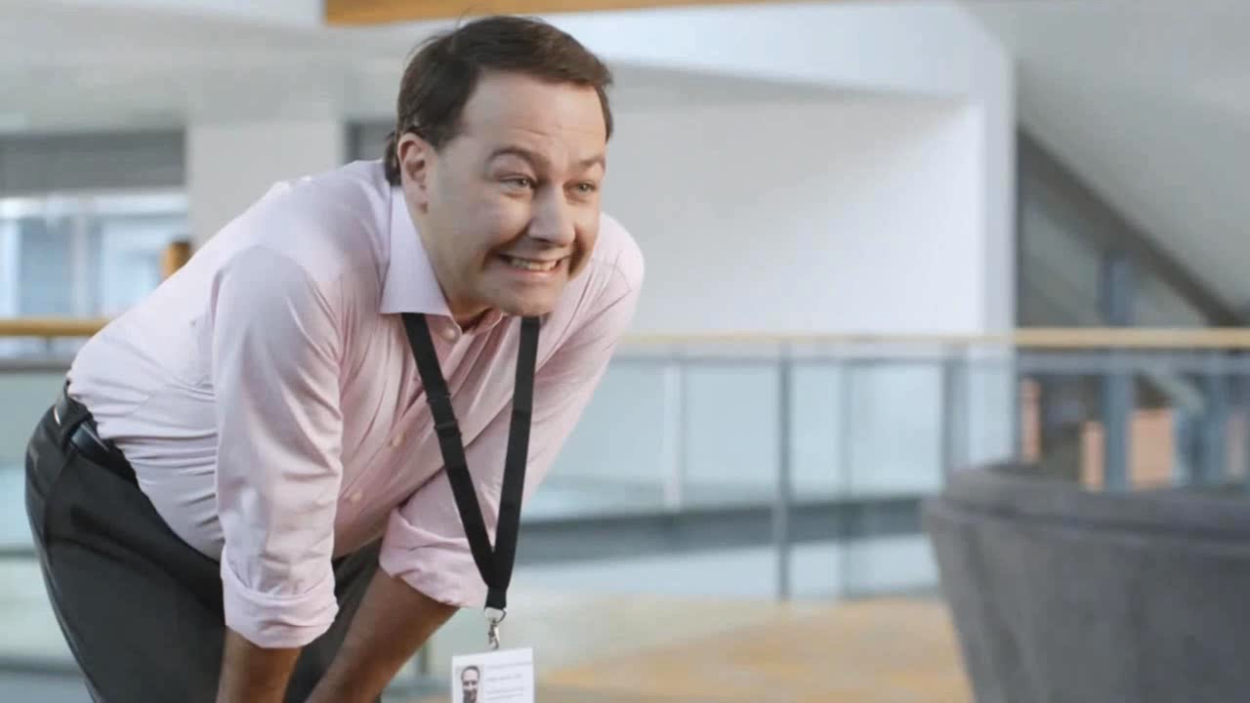
How Would You Have Handled It?

Slide 17
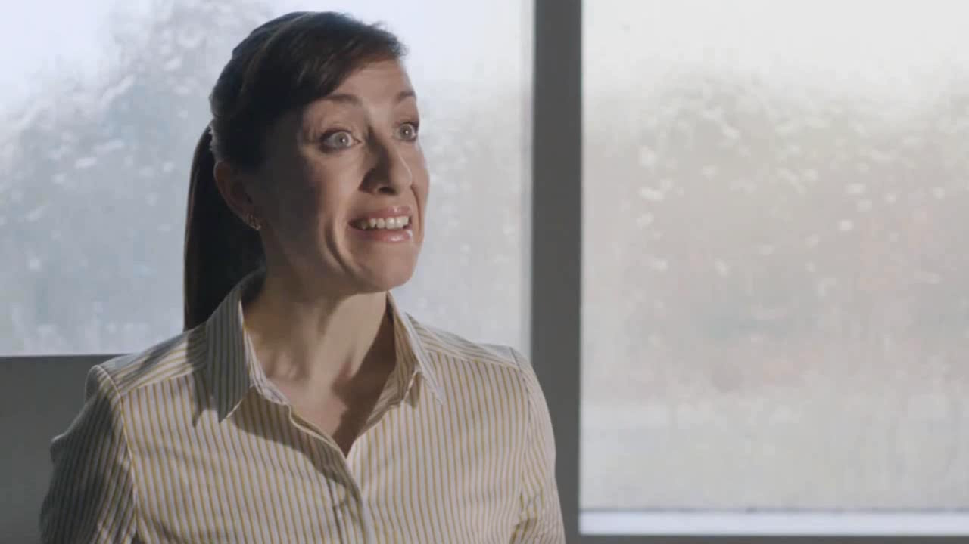
Would You Have Handled It Well?

Slide 18
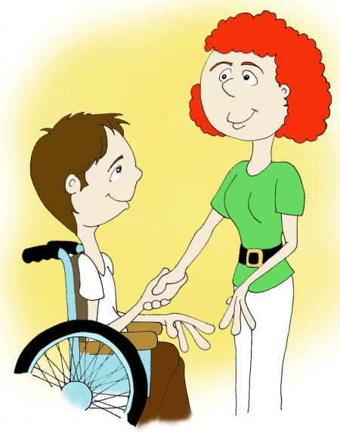
RELAX
Hi, It’s Very Nice To Meet You. Did You Walk Have A Nice Walk Over..
Please, Just Stop Talking.
Trying to avoid drawing attention to a person’s disability typically makes conversation more awkward…
I Mean…
Um…
Well…
Obviously You Didn’t…
I Mean…
Uh…Er…
…It’s okay to say “See you later” to a person that is blind, or “Did you hear about…?” To someone who is deaf.
I…Uh…Um…
Did You Drive Over?
Or, Can…um…
Can You Even Drive?
I Mean…
Oh, Gosh!
I…Uh…
Oh My Goodness!
Notes:
#10

Slide 19
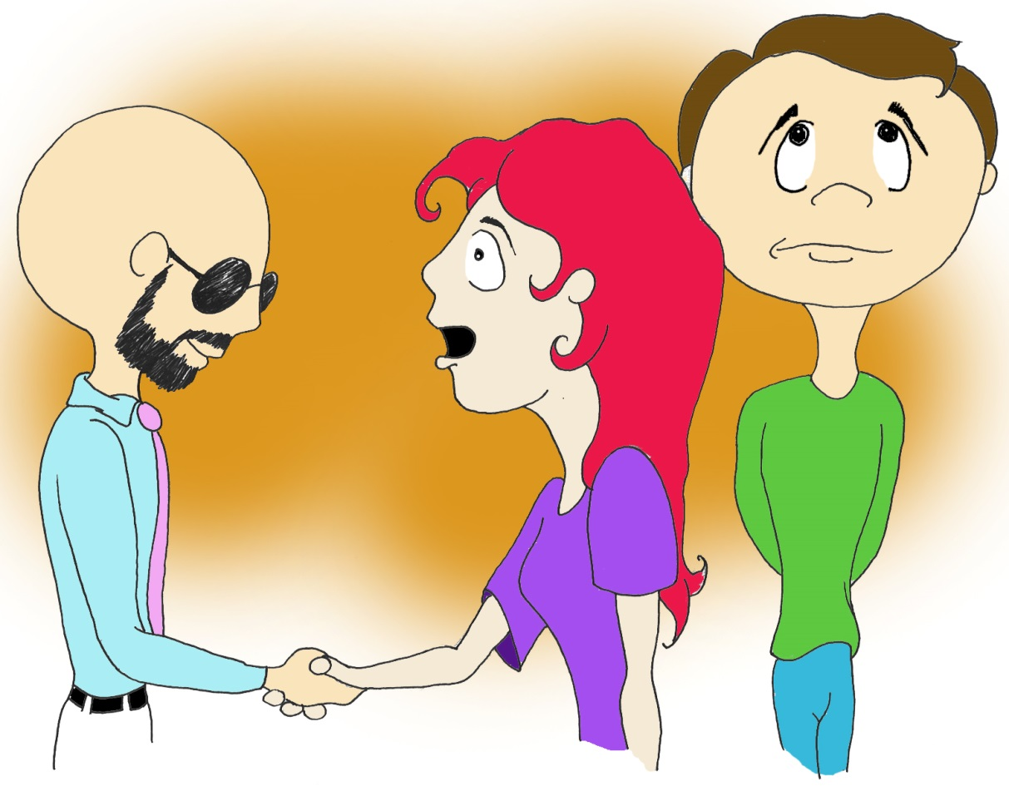
TREAT ADULTS ADULTS
AS
HI, BILLY! MY NAME I MRS. JEFFRIES!
I AM THE SOCIAL WORKER!
My name is William.
I Can’t Believe she just called me “Little Tommy”…I’m 37 Years Old!
Why is this person screaming at me?
THIS IS LITTLE TOMMY!
HE’S A PERSON WITH A DISABILITY THAT I HELP.
DO YOU UNDERSTAND THAT?
Ask the person what name they prefer to go by and avoid speaking to them in a patronizing tone

Slide 20
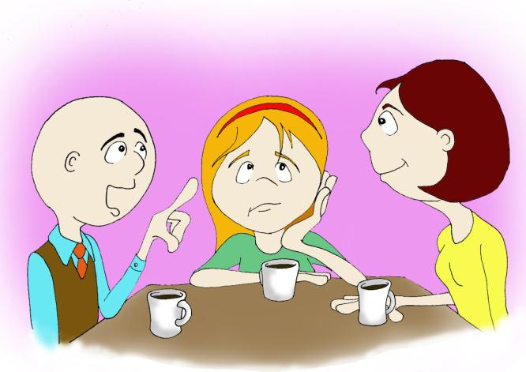
TALK PERSON
TO THE
I Thought I Would Go See A Movie Tonight...
Hello?! I’m Sitting Right Here!
I Think She Would Love That…
And I hate Movies!
…And It Would Be Good For Her To Get Out Of The House For Awhile.
…Do You Think Suzy Would Like To Go?
Speak directly to the person instead of a companion or care provider
…even if it is an interpreter

Slide 21
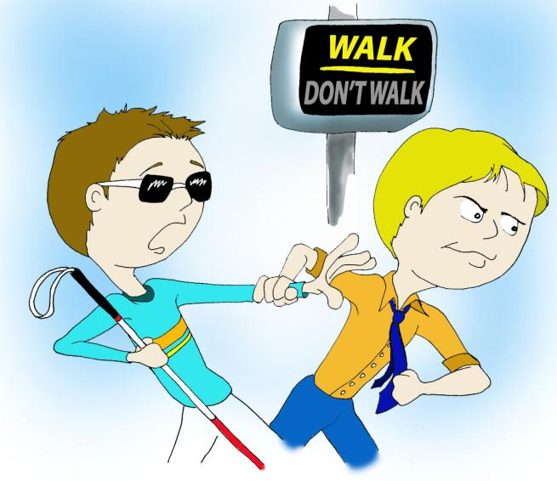
ASK SOMEONE
BEFORE YOU HELP
Offer your assistance and then wait for the person to accept your offer…
Don’t Worry, I’ve Got Ya’!
Hey, Whoa!
What Are You
Doing?!
Let Me
Go!!
…and allow them to explain to you HOW you can assist them
Notes:
When speaking to a person with a visual disability:
always identify yourself & anyone with you.
Identify who you are talking to if in a group.
When dining, ask if you may describe what is on their plate to them

Slide 22
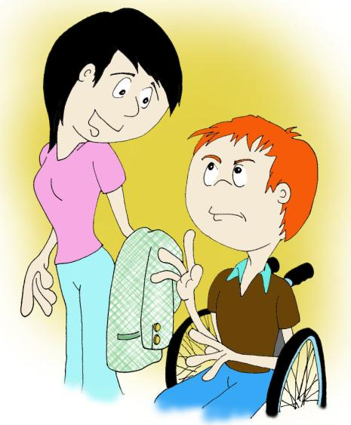
A PERSON’S WHEELCHAIR IS AN
EXTENSION BODY
OF THEIR
Always respect their personal space.
Do not lean or hang on someone’s wheelchair
Do not ask them to hold or carry things for you
Do not just grab their chair and push them
Could you carry this for me?
Thanks…
you’re a doll!

Slide 23
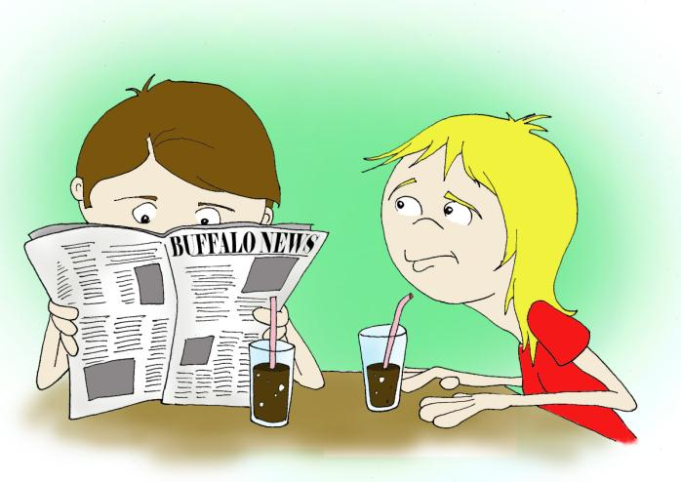
SPEAK DIRECTLY TO A PERSON WITH A
HEARING DISABILITY
It says here that the person from that place that did that thing with the stuff is doing more things for those people…
First get the person’s attention and then:
Look directly at the person
Speak clearly and slowly
Speak expressively
Keep hands, food, etc. away from your mouth
Avoid covering your face or turning away from the person
DON’T SHOUT AT THEM
What Is He Saying?!

Slide 24
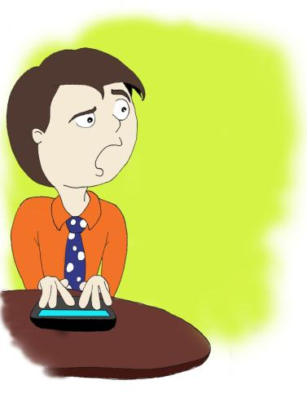
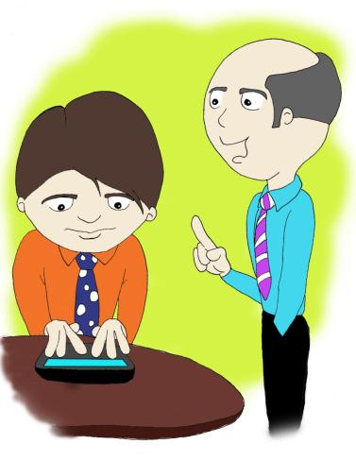
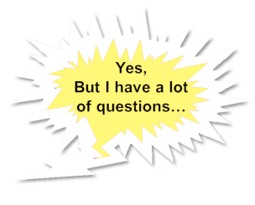
BE RESPECTFUL WHEN TALKING TO PEOPLE WHO
COMMUNICATE DIFFERENTLY
Hey Tom…
Did You Read That Memo About The New Policy, Yet?
Hey…Where’d He Go?
Click
Click
Click
Give people that use alternate forms of communication time to respond

Slide 25
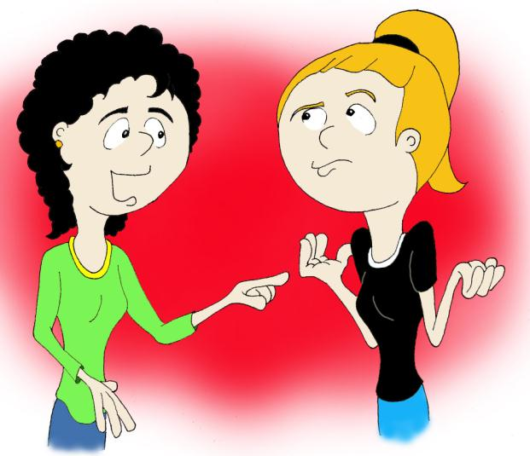
BE RESPECTFUL WHEN TALKING TO PEOPLE WHO
COMMUNICATE DIFFERENTLY
Weer Hafinga Bardee Ab Werg Vor Theeries Birktay Damorroo.
Um…Okay?
Yeah, Sure…
I Think…
Maybe?
Bill Thoo Big Da Gake?
If you didn’t understand a person with a speech disability,
it is okay to ask them to repeat themselves
Notes:
Don’t pretend to understand what they are saying.
If necessary, ask short questions that require short answers or even a nod of the head.
Repeat what you did understand and allow the person to fill in the rest.
It is okay to ask them to repeat themselves as many times as it takes to understand them.

Slide 26
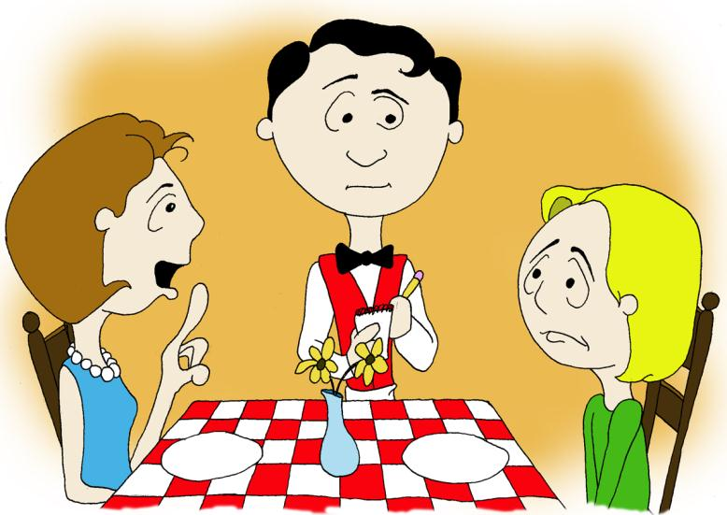
BE RESPECTFUL WHEN TALKING TO PEOPLE WHO
COMMUNICATE DIFFERENTLY
She Said She Wants The Ravioli With Meat Sauce
I Can Say It Myself
Ask if it is okay before interpreting or speaking for someone.
Notes:
If the person they are talking to looks to you for an interpretation, you should try to redirect them back to the individual.
If the person is struggling, ask them if it is okay to interpret for them, and then make sure you interpreted correctly.

Slide 27
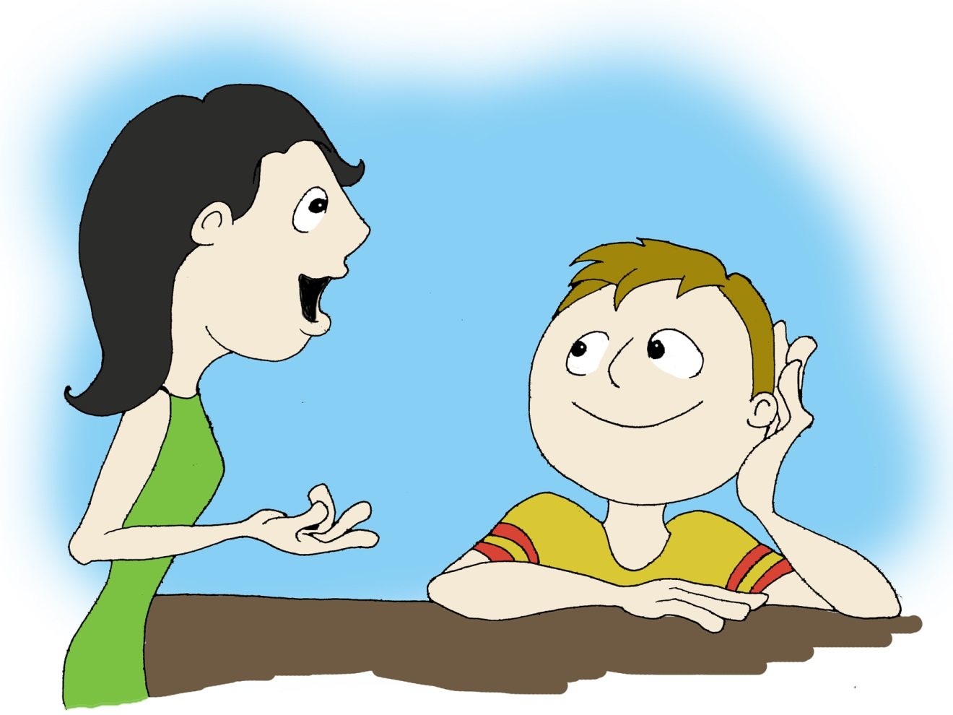
BE RESPECTFUL WHEN TALKING TO PEOPLE WHO
COMMUNICATE DIFFERENTLY
So I Said To The Waiter “This Isn’t What I Ordered.”
That would make me so mad.
What?
And Do You Know What He Said To Me?
“Well, Just Try It, You May Like It Better.”
I totally agree.
I Mean, Who Does He Think He Is?
My Mother?
And Then…
Make an effort to have conversations with people who lack verbal abilities
Notes:
Have typical conversations with the person even if they can’t respond verbally.

Slide 28
Any Questions?

