Slide 1
Research-informed Bullying prevention: Social-emotional learning & school climate improvement approaches
Dorothy L. Espelage, Ph.D.
William C. Friday Distinguished Professor of Education
University of North Carolina at Chapel Hill, USA

Slide 2
Espelage Research Lab
  SOCIAL-ECOLOGY & SCHOOL-BASED PREVENTION (Espelage & Swearer, 2003; Espelage, 2012, 2014)
  EXPOSURE TO VIOLENCE STUDY (Espelage, 1998; Low & Espelage, 2014)
  SOCIAL NETWORK ANALYSIS STUDY (Birkettt & Espelage, 2014; Espelage, Holt, & Henkel, 2003; Espelage, Green, & Wasserman, 2007; Espelage, Green, & Polanin, 2012)
  SEXUAL HARASSMENT, DATING VIOLENCE, & BULLYING STUDIES (Holt & Espelage, 2003; Holt & Espelage, 2005; Espelage & Holt, 2006; Espelage, Basile, & Hambuger, 2012, 2014)
  THEORY OF MIND, EMPATHY, & PEER RELATIONS (Espelage et al., 2004; Mayberry & Espelage, 2006)
  SEXUAL VIOLENCE, & BULLYING (Poteat & Espelage, 2006; Espelage et al., 2008; Espelage et al., 2012)
  YOUTH & MENTAL HEALTH OUTCOMES (Espelage, Aragon, Birkett, & Koenig, 2008; Poteat, Espelage, & Koenig, 2009; Birkett, Espelage, & Koenig, 2009; Robinson & Espelage, 2012, 2013)
  STUDENTS WITH DISABILITIES - Victimization & Psychological Correlates & SEL prevention (Rose et al., 2010; Rose & Espelage, 2012; Espelage, Rose, & Polanin, 2015)
  SCHOOL CLIMATE, ACADEMIC ENGAGEMENT (Espelage et al., 2014, 2015)

Slide 3
Funding Sources & Disclaimer
Research was supported by Centers for Disease Control & Prevention (#1U01/CE001677) to Dorothy Espelage (PI); Opinions, findings, and conclusions or recommendations expressed in this presentation are those of the author(s) and do not necessarily reflect those of the CDC
Research was supported by NIJ Grant (MUOFX-0022) to Dorothy Espelage (PI) & Sabina Low (co-PI); Opinions, findings, and conclusions or recommendations expressed in this presentation are those of the author(s) and do not necessarily reflect those of the Department of Justice
Research was supported by NIJ Grant (#2015-MU-MU-K003 ) to Iris Ed, Vincent, Espelage, Walker (co-PIs); Project SOARS (Student Ownership, Accountability, and Responsibility for School safety). National Institutes of Justice (IRIS Ed)

Slide 4
Espelage Mantra:
With Awareness Comes Misperception
Misperception in Media Scientific Evidence
-Bullying is an epidemic. -Bully Rates Vary
-Bully-suicide linked. -Bully Only One of Many Predictors
-Bully are young criminals. -Bullies are diverse in their outcomes
-Bullies need to be punished. -Ignores Group Phenomena
-Bullies – dysfunctional families -Good kids get involved in bullying
-Bullying is hard-wired in youth -Environment matters – gene expression

Slide 5
Policies & Procedures –Behavioral Expectations (PBIS)
Ongoing ALL Staff
Training
Effective Bully/Violence Prevention
Social-Emotional Competences
Notes:
Research shows that really effective school-based bullying prevention must be comprehensive and in particular include three major components: Social emotional competence, establishing good policies and procedures, and good staff training on the topic. I will now go over each of these components in more detail.

Slide 6
Definition of Bullying
(CDC; Gladden et al., 2014)
Bullying is unwanted aggressive behavior(s) among school-age children that has a high likelihood of causing physical or psychological harm or injury and is characterized by:
1) an imbalance of real or perceived power that favors the aggressor(s);
2) is repeated or has a high likelihood of being repeated;
3)The victim(s) of bullying may feel intimidated, demeaned, or humiliated as a result of the aggression.

Slide 7
Components Matter
(Ybarra, Espelage, & Mitchell, 2014; JAH)
Nationally-representative samples: (1) 2008: 1,157 12- to 17-year-olds; (2) 2010-11: 3,989 13- to 18-year-olds.
Youth who reported neither differential power nor repetition had the lowest rates of interference with daily functioning.
Youth who reported either differential power or repetition had higher rates.
Highest rates of interference with daily functioning were observed among youth who reported both differential power and repetition; these youth report highest level of helplessness.
Youth were victims of online generalized peer aggression (30%) or both online generalized peer aggression and cyberbullying (16%) but rarely cyberbullying alone (1%).

Slide 8
Bullying Prevalence
Among 3rd – 8th graders:
  15% Chronically Victimized
  17% Ringleader Bullies
  8% Bully-Victims
  60% Bystanders
    Only 13% intervene to help victim
        (Espelage, 2015)

Slide 9
Definition of Cyber-Bullying
(Hinduja & Patchin, 2009)
Cyberbullying is defined as “willful and repeated harm inflicted through the use of computers, cell phone, or other electronic devices” (p. 5).
Utilizing technology, youth can send or post humiliating or threatening messages or photos of their targets to a third party or to a public forum where many online participants visit (Hinduja & Patchin, 2009).

Slide 10
Cyber-Bullying Prevalence
7% of students in U.S. public schools nationwide reported being cyberbullied in 2013 (Zhang, Musu-Gillette, & Oudekerk, 2016).
Rate of cyberbullying is lower than the rate of face-to-face bullying victimization (22%), th
Cyberbullied students were less likely to notify an adult than face-to-face bullying victims (23% vs. 39%; Zhang et al., 2016).
Review of cyberbullying literature by the rate to be anywhere between 4% and 78% (Aboujaoude, Savage, Starcevic, & Salame, 2015).

Slide 11
Transactional Associations
Between School-Based
Aggression/Bullying & Cyberbullying
This research was supported by Centers for Disease Control & Prevention (#1U01/CE001677) to Dorothy Espelage (PI)

Slide 12
Method
Participants
  1,132 students (49.1% female)
  3 cohorts (5th, 6th, 7th graders)
  Assessed across 4 waves including Spring/Fall 2008, Spring/Fall 2009
  Racially diverse (51% Black; 34% White;
  3% Hispanic; 3% Asian; 9% Other)

Slide 13
Bullying Perpetration & Cyberbullying Perpetration
Espelage, Rao, & Craven, 2013
Notes:
Longitudinal structural equation modeling was used to examine longitudinal associations between face-to-face and cyberbullying perpetration. An item-to-construct balance method was used to develop parcels for both the scales (Little et al., 2002). The measurement model was established and strong factorial invariance was demonstrated. The structural model that was then imposed provided good ﬁt to the data, χ² _{(219, n=1132)}= 945.318; RMSEA = 0.0542 _{(0.0506 ; 0.0577)}; NNFI = .0975; CFI = 0.980. The results of the model tested are shown in Figure 1.
These results indicated that higher bullying perpetration at an earlier time point was predictive of increases in cyberbullying perpetration in consecutive time points (after controlling for previous cyberbullying behaviors). Engagement in cyberbullying perpetration did not predict increases in traditional bullying in our data. These results support our hypothesis that bullying perpetration is an antecedent of cyberbullying perpetration in middle school. Findings from this study provide strong support for the link between bullying perpetration and cyberbullying perpetration among a large sample of young adolescents. Bullying perpetration emerged as a precursor to cyberbullying perpetration across 2 years and 4 waves of survey data. This study suggests that cyberbullying may be an extension of other bullying behaviors. It is possible that as children get older and increase their engagement with technology, cyberspace becomes another context within which bullying perpetration occurs. Given the substantial predictive power of face-to-face bullying to cyberbullying, bullying prevention programs need to consider how face-to-face encounters in school might spill over into cyberspace where adult monitoring and intervention is relatively absent.

Slide 14
Bullying Victimization and Cyberbullying Perpetration
Espelage, Rao, & Craven, 2013
Notes:
The structural provided good ﬁt to the data χ² _{(222, n=1132)}= 854.147; RMSEA = 0.0486 _{(0.0453 ; 0.0525)}; NNFI = .0965; CFI = 0.972. Results shown in Figure 2, indicate a transactional model, with predictive cross-lagged coefficients across the four waves. This suggests that peer victimization and cyberbullying perpetration operate within a reciprocal influence model. This provides support for both theories, although, initially cyberbullying perpetration predicts peer victimization. It is possible that when youth who do not have status in face-to-face contexts engage in cyberbullying, it puts them at particular risk for peer victimization, which in turn causes them to retaliate in the more removed, safe, cyber space.

Slide 15
Theoretical Framework
Bullying can be broadly construed as social interactions (or social dynamic) that are influenced, maintained or mitigated by relationships in the school, peer, and familial contexts (Pepler et al., 2006; Espelage, 2016).
Social interactional learning model - family violence serves as an important context for understanding the relation between bullying perpetration and involvement in anger, alcohol use, and delinquency as predictors of sexual harassment perpetration and teen dating violence (Espelage et al. 2014; Rinehart, Espelage, & Bub, 2017).
Gendered harassment (sexual harassment, homophobic name-calling) - reinforces traditional masculinity that is emotionally restrictive, competitive, and aggressive (Levant, 1996; Pleck, 1995; Meyer, 2008).

Slide 16
Longitudinal Study Participants
Longitudinal data drawn from 4 Midwestern middle schools and 6 high schools from spring 2008 to spring 2013
  Waves 0-3 (middle school) and waves 4 and 5 (high school) used in analysis
  n = 3,549; M age = 12.8 years
    32.2% white, 46.2% black, 5.4 % Hispanic, and 10.2% other; 50.2% female
Parent and student assent collected
Teams of researchers administered self-report surveys

Slide 17
Bullying Perpetration & Sexual Violence Perpetration Among Middle School Students: Gender-Based Bias Matters
Dorothy L. Espelage, Ph.D.
University of Florida
Lisa De La Rue, Ph.D.
University of San Francisco
&
Kathleen C. Basile, Ph.D.
Division of Violence Prevention
Centers for Disease Control & Prevention, Atlanta, Georgia
Merle E. Hamburger, Ph.D.
Journal of Adolescent Health (2012), Journal of Interpersonal Violence (2014); Journal of Youth & Adolescence (2019)
This research was supported by Centers for Disease Control & Prevention
(#1u01/ce001677) to Dorothy Espelage (PI)
Notes:
Short talk
Quickly go through what's going on …usage, rates, etc.
And then provide some practical tips that parents can use
No Kinda

Slide 18
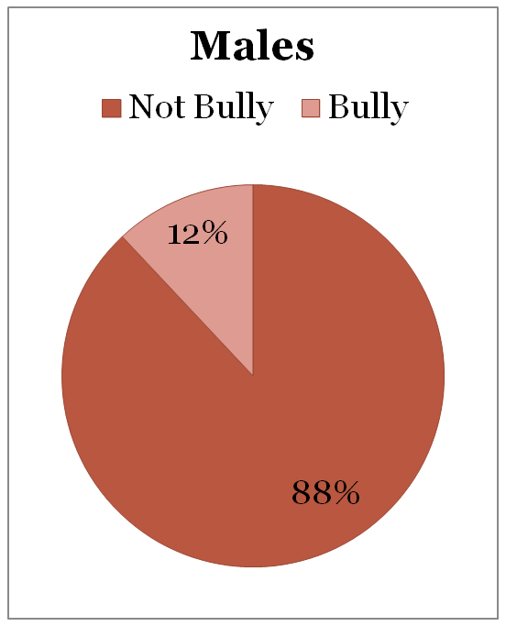
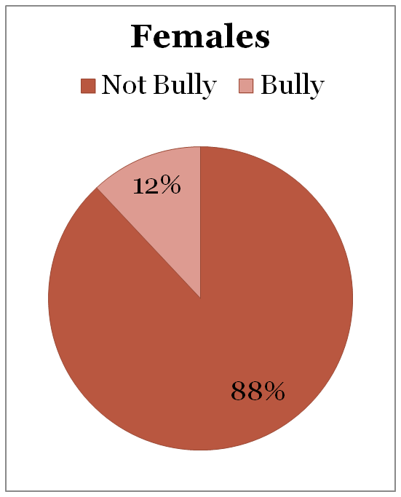
Percentages of Youth who Bully

Slide 19
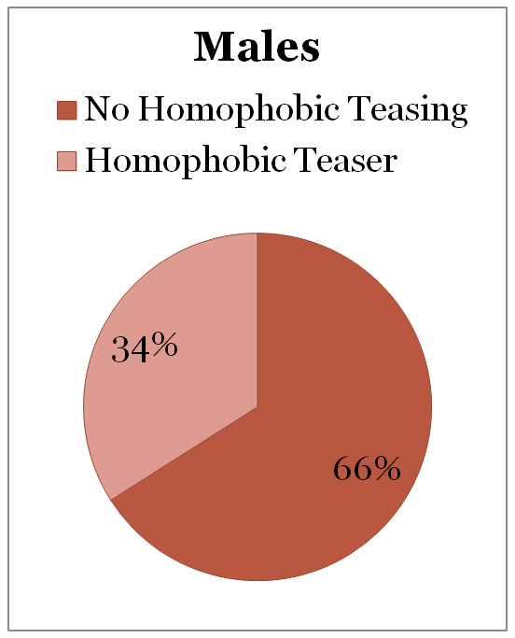
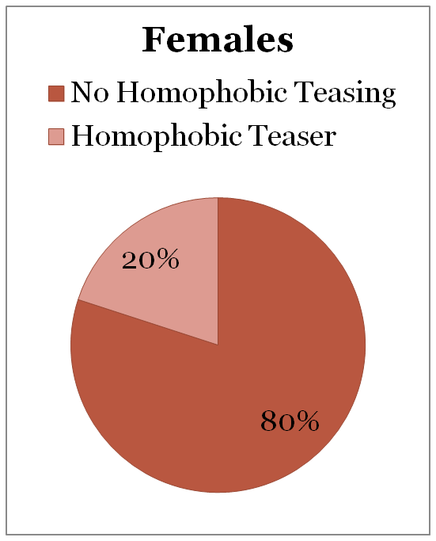
Percentages of Youth Who Engage in Homophobic Name-Calling

Slide 20
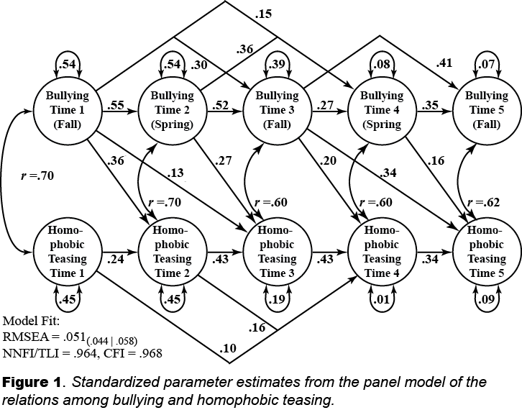
Bullying – Homophobic Teasing Perpetration
(Espelage et al., under revision; Little, 2013)

Slide 21
Take-Away Messages
Homophobic name-calling is prevalent in middle school (Meyer, 2009, 2010).
Youth who bully resort to homophobic name-calling over the middle school years.
Bully prevention programs should include a discussion of language that marginalizes gender non-conforming and lesbian, gay, bisexual (LGB) youth.

Slide 22
Longitudinal Results
Bullying
Perpetration
Wave 1
+
+
Sexual Harassment
Perpetration
Wave 2 (5)
Homophobic Teasing
Perpetration
Wave 1
+
+
Controlling for:
Sexual Harassment
Perpetration
Wave 1
+
(Espelage, Basile, & Hamburger, 2012; Espelage, Basile, & De La Rue, 2014; Espelage et al., 2019)

Slide 23
Take-Away Messages
Strong longitudinal associations among bullying, homophobic bantering, and sexual harassment perpetration.
For boys, bullying sexual violence link moderated by homophobic name-calling (Espelage et al., 2014)

Slide 24
Multi-Mediation Effect
Homophobic Perpetration
B = 1.9 (0.16)
AOR = 6.73
B = 0.41 (0.03)
B = 1.21 (0.21)
OR = 3.31
Bullying
Perpetration
Sexual Violence
Perpetration
B = 0.13 (0.01)
Homophobic
Victimization
B = -0.67 (0.18)
AOR = 0.51
Espelage, Basile et al., 2019

Slide 25
Additional moderators
Traditional masculinity ideology – Linked to gender-based harassment (Horn, 2007, Parrott, 2009, Pleck, 1995)
Social dominance – Linked to bullying & sexual harassment (McMaster et al., 2002; Pellegrini, 2001; Volk, Camilleri, Dane, & Marini, 2012)
Dismissive attitudes toward sexual harassment – Associated with greater sexual violence perp and victimization (Charmaraman, Jones, Stein, & Espelage, 2013; Rogers et al., 2017)

Slide 26
Discussion
A comprehensive approach that addresses the climate that may give potential perpetrators the license to perpetrate is important and may diffuse risk for sexual violence perpetration later in high school and emerging adulthood.
Another important piece of prevention programming suggested by this research is counteracting perceptions of gender non-conformity (Messerschmidt, 2000; Meyer, 2008).

Slide 27
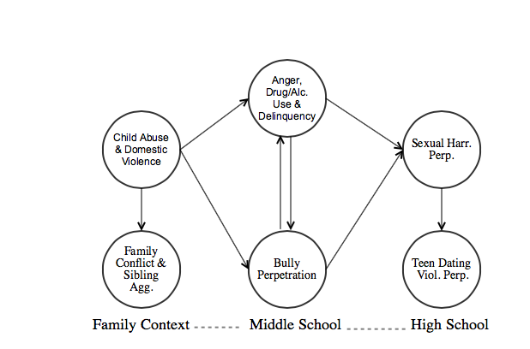
Developmental model of bullying, sexual harassment and dating violence
NIJ Grant (MUOFX-0022) to Dorothy Espelage (PI)
Espelage, Low, Anderson, & De La Rue, 2014

Slide 28
Implications for Prevention
Research must consider multiple contexts to identify longitudinal predictors, mediators, moderators associated with outcomes for youth who bully and later forms of violence.
Bullying programs need to incorporate discussion of gender-based name-calling, sexual violence, and gender expression (homophobic language; Birkett & Espelage, 2010; Meyer, 2009, 2010; Espelage, 2016).

Slide 29
Social-Ecological Perspective
Society
Community
School
/Peers
Family
Child
(Bronfenbrenner, 1979; Espelage & Horne, 2007; Espelage, 2014)

Slide 30
Individual Correlates of Bullying Involvement
Depression/Anxiety
Empathy
Delinquency
Impulsivity
Other forms of Aggression
Alcohol/Drug Use
Positive Attitudes toward Violence/Bullying
Low Value for Prosocial Behaviors
For review (Espelage & Horne, 2007; Espelage & Holt, 2012; Espelage & Hong, 2012; Espelage et al., 2019)

Slide 31
Affective-Cognitive Empathy & Bullying Behavior
A recent meta analysis:
38 studies on affective empathy
24 studies on cognitive empathy
Relation with bullying behaviors indicated that there is support for the association of lower levels of empathy and bullying –
Particularly for affective empathy (Van Noorden et al., 2015).
Nickerson et al. 2015 – links to defending behavior.

Slide 32
Attitudes Supportive of Bullying and Bullying Perpetration
Boulton et al. (1999) found that among Swedish and English secondary school students (n=210):
> Supportive attitudes towards bullying significantly predicted involvement in bullying behaviors after controlling for sex.
Salmivalli & Voeten (2004) found that among 1220 elementary school children (600 girls and 620 boys) from 48 school classes:
>Attitudes towards bullying moderately predicted bullying behavior after controlling for sex.

Slide 33
Findings suggest that targeting affective empathy and attitudes supportive over time within youth appears to be a fruitful prevention strategy.

Slide 34
Meta-Analytic Study
Cook, Williams, Guerra, Kim, & Sadek (2010)
  Reviewed 153 studies since 1970
  Youth who bully other students: have significant externalizing behavior, social competence and academic challenges, negative attitudes toward others, family characterized by conflict
  Peer Status & Bully varied by age: Adolescents who bully have higher peer status than children who bully others

Slide 35
Social Network Studies: Peers Matter
Homophily hypothesis supported in social network studies – early adolescence:
Bully perpetration – selection & socialization (Espelage et al. 2003; Merrin et al., 2019)
Homophobic name-naming/Sexual harassment – selection & socialization (Poteat, Espelage, & Green, 2007; Tucker et al., 2016)
Willingness to Intervene – socialization (Espelage, Green, & Polanin, 2012; Ingram, Espelage et al., 2019)

Slide 36
Bystander Interventions
(Polanin, Espelage, & Pigott, 2011)
Meta-analysis synthesized the effectiveness of bullying prevention programs in altering bystander behavior to intervene in bullying situations.
Evidence from twelve school-based interventions, involving 12,874 students, revealed that overall the programs were successful (ES = .21, C.I.: .12, .30), with larger effects for high school samples compared to K-8 student samples (HS ES = .44, K-8 ES = .13; p = .001).
Analysis of empathy for the victim revealed treatment effectiveness that was positive but not significantly different from zero (ES = .05, CI: -.07, .17).
Nevertheless, this meta-analysis indicated that programs were effective at changing bystander behavior both on a practical and statistically significant level.

Slide 37
Bystander Interventions
(Polanin, Espelage, & Pigott, 2011)

Slide 38
Family & School Risk Factors
FAMILY
  Lack of supervision
  Lack of attachment
  Negative, critical relationships
  Lack of discipline/ consequences
  Support for violence
  Modeling of violence
SCHOOL
  Lack of supervision
  Lack of attachment
  Negative, critical relationships
  Lack of discipline/ consequences
  Support for violence
  Modeling of violence
  For review (Espelage, 2012; Espelage & Horne, 2007; Espelage, Hong, & Carter, 2019)

Slide 39
Latent Class = Sibling, Family, & Peer Aggression
Membership %
16.56% - High All
32.10% - Sib/Family
11.00% - Peer Aggression
40.38% - Low Aggression
(Ingram, Espelage, Davis, & Merrin, in press)

Slide 40
Parental Monitoring & Bullying
Long term consequences for bullying perpetration and victimization
Parental monitoring + bullying perpetration= mixed associations
Life course perspective and fight for autonomy
Childhood, adolescence, & emerging adulthood
Relationships (studied)
Monitoring (not so much)
Cyclical relationships between parenting and youth behavior(s)
Doty, Lynne, Metz, Yourell, & Espelage
(2019) - University of Florida

Slide 41




Parental Monitoring & Bullying
Bullying perpetration predicted lower perceived parental monitoring
Youth may be encouraged by believing they can “get away with” bullying involvement
Bi-directional effects between parenting and youth behavior
Transition to high school is pivotal for parental monitoring
Doty, Lynne, Metz, Yourell, & Espelage
(2019) - University of Florida

Slide 42
Parental/Family Components in Bully Prevention Programs – Meta-Analysis
22 studies; 212,211 K-12 students; a small, significant effect on reducing bully perpetration (d = 0.179, 95% CI= [0.095, 0.264])
(Huang, Espelage, & Polanin, 2019)

Slide 43
Parental/Family Components in Bully Prevention Programs – Meta-Analysis
22 studies; 212,211 K-12 students a small, significant effect on reducing victimization (d = 0.162, 95% CI= [0.059, 0.265]).
(Huang, Espelage, & Polanin, 2019)

Slide 44
Family X School Belonging Interaction
(Merrin, Espelage, & Hong, 2016)
Figure. Interaction among Between-Person Dysfunctional Family and Between-Person School Connectedness. Note: High = +1 SD, M = Average, Low = -1 SD. Simple Slopes: High: β = -.10, SE = .01, p < .001; M: β = -.07, SE = .01, p < .001; and Low: β = -.03, SE = .01, p < .003.

Slide 45
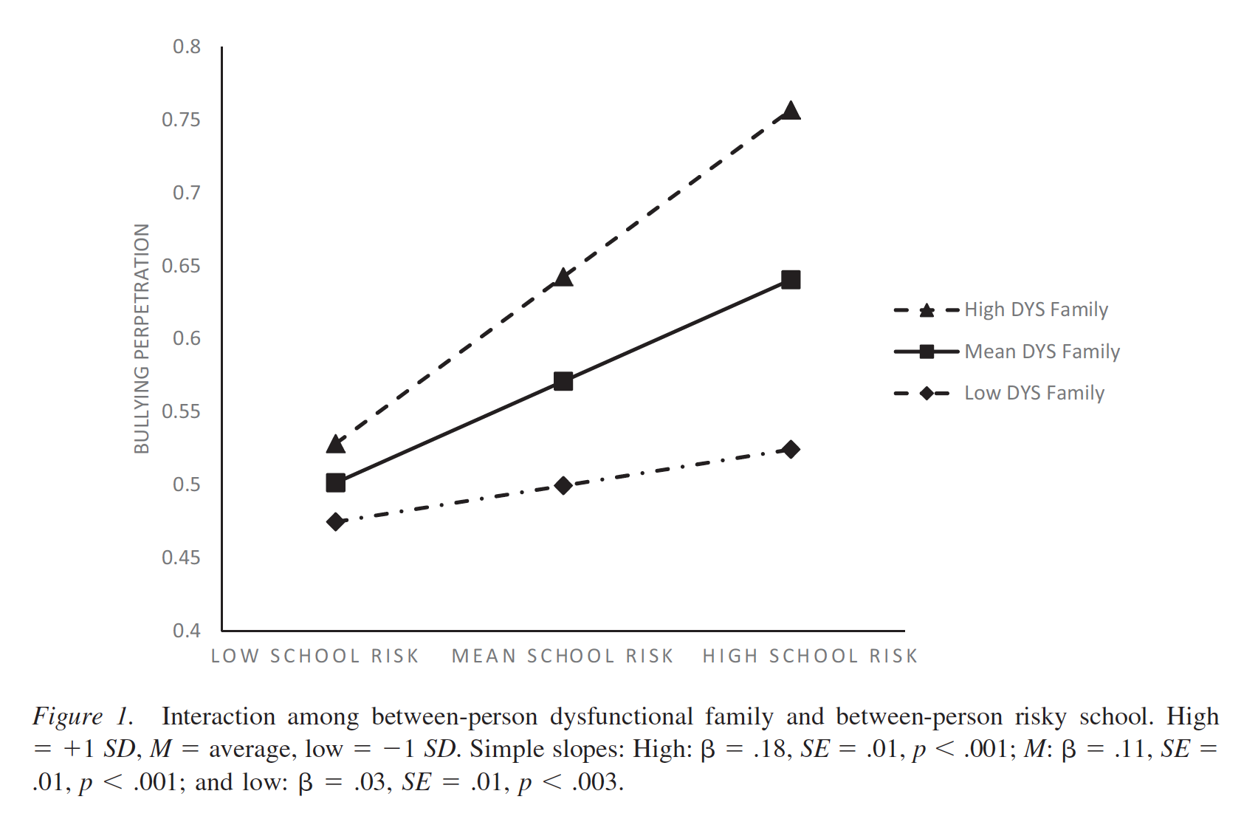
Family X Risky School Interaction
(Merrin, Espelage, & Hong, 2016)

Slide 46
Developmental Lens
Meta-Analysis:
Yeager, Fong, Lee, &
Espelage (2015)

Slide 47

Good policies and procedures set the groundwork for promoting a safe and positive climate – contributes to less bullying
Espelage et al., 2014; 2019
Notes:
Second, schools must put into place policies and procedures that outline actions to take against bullying. These policies and procedures are important and necessary in setting the groundwork for promoting a safe and positive climate for students. This is where building administration and leadership is important, this is where they can set the tone in terms of policies and procedures for the school. And in addition, can help make staff aware of these policies and procedures so that they can be implemented appropriately. Research has shown that effective disciplinary actions, leads to reductions in bullying behavior, which highlights the importance of putting in place good policies and procedures.
Building-level leadership is the KEY to successful adoption and implementation of any school-based prevention program. They can not only make the initiative a priority in their schools, they can motivate their staff, and provide support throughout the school year.

Slide 48
Teacher/Staff Perceptions of School Culture: Links to Student Reports of Bullying, Victimization, Aggression, & Willingness to Intervene
Dorothy L. Espelage, Ph.D.
Joshua Polanin, Ph.D.
Sabina Low, Ph.D.
School Psychology Quarterly (2014)
This research was supported by Centers for Disease Control & Prevention (#1U01/CE001677) to Dorothy Espelage (PI)

Slide 49
School Culture Matters
“school policies, attitudes and behaviors of teachers, administrators and the student body, and the overall atmosphere or school ethos, determine the internal life or social, emotional, and motivation climate of the school.” (Kasen et al., 2004).

Slide 50
School Environment Scale
Six scales emerged from factor analyses, measuring teacher/staff PERCEPTIONS OF:
  Student intervention (5 items; α = .83)
  Staff intervention (5 items; α = .89)
  Aggression being a problem (5 items; α = .80)
  School is doing professional development/administrator support (8 items; α = .90)
  Positive school climate overall (7 items; α = .85)
  Gender Equity/Intolerance of Sexual Harassment (7 items; α = .79)

Slide 51
Final Multi-level Model
Variable | Bullying Perpetration |  | Peer Victimization |  | Physical Aggression |  | Willingness to Intervene
 | β (SE) | B | β (SE) | B | β (SE) | B | β (SE) | B
Intercept | .39 (.03)** | - | .96 (.04)** | - | .96 (.05)** | - | 2.03 (.04)** | -
Individual
Female | -.03 (.02) | -.03 | -.05 (.03) | -.05 | -.20 (.03)** | -.21 | .14 (.02)** | .14
Mother’s Education | .01 (.01) | .01 | .01 (.03) | .03 | -.01 (.01) | -.03 | .02 (.01)** | .08
White | .17 (.02)** | -.15 | .11 (.05)* | .10 | -.51 (.05)** | -.47 | .18 (.03)** | .17
Hispanic | -.17 (.02)** | -.17 | -.23 (.05)** | -.23 | -.47 (.05)** | -.46 | .09 (.03)** | .09
Asian | -.22 (.04)** | -.07 | -.13 (.07) | -.04 | -.64 (.06)** | -.21 | .19 (.05)** | .06
Bi-racial | .11 (.03)** | -.08 | -.01 (.08) | -.01 | -.29 (.05)** | -.2 | .12 (.03)** | .08
School-level
Student Intervention | .15 (.14) | .04 | -.03 (.18) | -.01 | .19 (.20) | .05 | -.07 (.10) | -.02
Staff Intervention | .15 (.10) | .04 | .30 (.22) | .07 | .02 (.19) | .01 | -.02 (.11) | -.01
Aggression Problem | -.07 (.08) | -.04 | -.14 (.12) | -.08 | .09 (.12) | .05 | -.18 (.06)** | -.10
School Commitment to Bully Prevention | -.20 (.06)** | -.13 | -.42 (.09)** | -.27 | -.17 (.08)* | -.11 | .08 (.05) | .05
Positive Teacher-Staff-Student Interactions | -.01 (.11) | .01 | .14 (.16) | .04 | -.23 (.21) | -.07 | -.13 (.08) | .02
Gender equity/intolerance of sexual harassment | -.23 (.10)* | -.08 | -.71 (.20)** | -.24 | -.13 (.14) | -.05 | -.13 (.08) | -.05
State | .05 (.05) | .05 | -.04 (.03) | -.04 | .05 (.07) | .05 | .03 (.04) | .03
Free/Reduced Lunch | .01 (.01) | .05 | -.01 (.01)* | -.14 | .01 (.02)* | .26 | -.01 (.01)* | -.12
% Female | -.66 (.29)* | -.07 | -.71 (.32)* | -.08 | -.45 (.42) | -.05 | .17 (.25) | .02
% White | .17 (.11) | .06 | -.49 (.15)** | -.18 | .64 (.24)** | .23 | -.25 (.11)* | -.09

Slide 52
Final Multi-level Model
Variable | Bullying Perpetration |  | Peer Victimization |  | Physical Aggression |  | Willingness to Intervene
 | β (SE) | B | β (SE) | B | β (SE) | B | β (SE) | B
Intercept | .39 (.03)** | - | .96 (.04)** | - | .96 (.05)** | - | 2.03 (.04)** | -
Individual
Female | -.03 (.02) | -.03 | -.05 (.03) | -.05 | -.20 (.03)** | -.21 | .14 (.02)** | .14
Mother’s Education | .01 (.01) | .01 | .01 (.03) | .03 | -.01 (.01) | -.03 | .02 (.01)** | .08
White | .17 (.02)** | -.15 | .11 (.05)* | .10 | -.51 (.05)** | -.47 | .18 (.03)** | .17
Hispanic | -.17 (.02)** | -.17 | -.23 (.05)** | -.23 | -.47 (.05)** | -.46 | .09 (.03)** | .09
Asian | -.22 (.04)** | -.07 | -.13 (.07) | -.04 | -.64 (.06)** | -.21 | .19 (.05)** | .06
Bi-racial | .11 (.03)** | -.08 | -.01 (.08) | -.01 | -.29 (.05)** | -.2 | .12 (.03)** | .08
School-level
Student Intervention | .15 (.14) | .04 | -.03 (.18) | -.01 | .19 (.20) | .05 | -.07 (.10) | -.02
Staff Intervention | .15 (.10) | .04 | .30 (.22) | .07 | .02 (.19) | .01 | -.02 (.11) | -.01
Aggression Problem | -.07 (.08) | -.04 | -.14 (.12) | -.08 | .09 (.12) | .05 | -.18 (.06)** | -.10
School Commitment to Bully Prevention | -.20 (.06)** | -.13 | -.42 (.09)** | -.27 | -.17 (.08)* | -.11 | .08 (.05) | .05
Positive Teacher-Staff-Student Interactions | -.01 (.11) | .01 | .14 (.16) | .04 | -.23 (.21) | -.07 | -.13 (.08) | .02
Gender equity/intolerance of sexual harassment | -.23 (.10)* | -.08 | -.71 (.20)** | -.24 | -.13 (.14) | -.05 | -.13 (.08) | -.05
State | .05 (.05) | .05 | -.04 (.03) | -.04 | .05 (.07) | .05 | .03 (.04) | .03
Free/Reduced Lunch | .01 (.01) | .05 | -.01 (.01)* | -.14 | .01 (.02)* | .26 | -.01 (.01)* | -.12
% Female | -.66 (.29)* | -.07 | -.71 (.32)* | -.08 | -.45 (.42) | -.05 | .17 (.25) | .02
% White | .17 (.11) | .06 | -.49 (.15)** | -.18 | .64 (.24)** | .23 | -.25 (.11)* | -.09

Slide 53
Final Multi-level Model
Variable | Bullying Perpetration |  | Peer Victimization |  | Physical Aggression |  | Willingness to Intervene
 | β (SE) | B | β (SE) | B | β (SE) | B | β (SE) | B
Intercept | .39 (.03)** | - | .96 (.04)** | - | .96 (.05)** | - | 2.03 (.04)** | -
Individual
Female | -.03 (.02) | -.03 | -.05 (.03) | -.05 | -.20 (.03)** | -.21 | .14 (.02)** | .14
Mother’s Education | .01 (.01) | .01 | .01 (.03) | .03 | -.01 (.01) | -.03 | .02 (.01)** | .08
White | .17 (.02)** | -.15 | .11 (.05)* | .10 | -.51 (.05)** | -.47 | .18 (.03)** | .17
Hispanic | -.17 (.02)** | -.17 | -.23 (.05)** | -.23 | -.47 (.05)** | -.46 | .09 (.03)** | .09
Asian | -.22 (.04)** | -.07 | -.13 (.07) | -.04 | -.64 (.06)** | -.21 | .19 (.05)** | .06
Bi-racial | .11 (.03)** | -.08 | -.01 (.08) | -.01 | -.29 (.05)** | -.2 | .12 (.03)** | .08
School-level
Student Intervention | .15 (.14) | .04 | -.03 (.18) | -.01 | .19 (.20) | .05 | -.07 (.10) | -.02
Staff Intervention | .15 (.10) | .04 | .30 (.22) | .07 | .02 (.19) | .01 | -.02 (.11) | -.01
Aggression Problem | -.07 (.08) | -.04 | -.14 (.12) | -.08 | .09 (.12) | .05 | -.18 (.06)** | -.10
School Commitment to Bully Prevention | -.20 (.06)** | -.13 | -.42 (.09)** | -.27 | -.17 (.08)* | -.11 | .08 (.05) | .05
Positive Teacher-Staff-Student Interactions | -.01 (.11) | .01 | .14 (.16) | .04 | -.23 (.21) | -.07 | -.13 (.08) | .02
Gender equity/intolerance of sexual harassment | -.23 (.10)* | -.08 | -.71 (.20)** | -.24 | -.13 (.14) | -.05 | -.13 (.08) | -.05
State | .05 (.05) | .05 | -.04 (.03) | -.04 | .05 (.07) | .05 | .03 (.04) | .03
Free/Reduced Lunch | .01 (.01) | .05 | -.01 (.01)* | -.14 | .01 (.02)* | .26 | -.01 (.01)* | -.12
% Female | -.66 (.29)* | -.07 | -.71 (.32)* | -.08 | -.45 (.42) | -.05 | .17 (.25) | .02
% White | .17 (.11) | .06 | -.49 (.15)** | -.18 | .64 (.24)** | .23 | -.25 (.11)* | -.09

Slide 54
Final Multi-level Model
Variable | Bullying Perpetration |  | Peer Victimization |  | Physical Aggression |  | Willingness to Intervene
 | β (SE) | B | β (SE) | B | β (SE) | B | β (SE) | B
Intercept | .39 (.03)** | - | .96 (.04)** | - | .96 (.05)** | - | 2.03 (.04)** | -
Individual
Female | -.03 (.02) | -.03 | -.05 (.03) | -.05 | -.20 (.03)** | -.21 | .14 (.02)** | .14
Mother’s Education | .01 (.01) | .01 | .01 (.03) | .03 | -.01 (.01) | -.03 | .02 (.01)** | .08
White | .17 (.02)** | -.15 | .11 (.05)* | .10 | -.51 (.05)** | -.47 | .18 (.03)** | .17
Hispanic | -.17 (.02)** | -.17 | -.23 (.05)** | -.23 | -.47 (.05)** | -.46 | .09 (.03)** | .09
Asian | -.22 (.04)** | -.07 | -.13 (.07) | -.04 | -.64 (.06)** | -.21 | .19 (.05)** | .06
Bi-racial | .11 (.03)** | -.08 | -.01 (.08) | -.01 | -.29 (.05)** | -.2 | .12 (.03)** | .08
School-level
Student Intervention | .15 (.14) | .04 | -.03 (.18) | -.01 | .19 (.20) | .05 | -.07 (.10) | -.02
Staff Intervention | .15 (.10) | .04 | .30 (.22) | .07 | .02 (.19) | .01 | -.02 (.11) | -.01
Aggression Problem | -.07 (.08) | -.04 | -.14 (.12) | -.08 | .09 (.12) | .05 | -.18 (.06)** | -.10
School Commitment to Bully Prevention | -.20 (.06)** | -.13 | -.42 (.09)** | -.27 | -.17 (.08)* | -.11 | .08 (.05) | .05
Positive Teacher-Staff-Student Interactions | -.01 (.11) | .01 | .14 (.16) | .04 | -.23 (.21) | -.07 | -.13 (.08) | .02
Gender equity/intolerance of sexual harassment | -.23 (.10)* | -.08 | -.71 (.20)** | -.24 | -.13 (.14) | -.05 | -.13 (.08) | -.05
State | .05 (.05) | .05 | -.04 (.03) | -.04 | .05 (.07) | .05 | .03 (.04) | .03
Free/Reduced Lunch | .01 (.01) | .05 | -.01 (.01)* | -.14 | .01 (.02)* | .26 | -.01 (.01)* | -.12
% Female | -.66 (.29)* | -.07 | -.71 (.32)* | -.08 | -.45 (.42) | -.05 | .17 (.25) | .02
% White | .17 (.11) | .06 | -.49 (.15)** | -.18 | .64 (.24)** | .23 | -.25 (.11)* | -.09

Slide 55
Teacher/Staff perceptions of school culture:
Links To Student Reports Of Gender-based Bullying
Sarah Rinehart, M.A.
University of Illinois, Urbana-Champaign
Dorothy L. Espelage, Ph.D.
University of Florida
Psychology of Violence (2015)
This research was supported by Centers for Disease Control & Prevention (#1U01/CE001677) to Dorothy Espelage (PI)

Slide 56
What about
Homophobic Name-calling?
Variable | Homophobic Name-calling Perpetration |  | Homophobic Name-calling Victimization
 | β (SE) |  | β (SE)
Gender equity/intolerance of sexual harassment | -.40 (.11)** |  | -.36 (.12)**
Rhinehart & Espelage, 2015

Slide 57
Meta-Analysis of Bully Prevention Programs
Ttofi & Farrington, 2011
Journal of Experimental Criminology
Decreases in rates of victimization were associated with the following special program elements:
  Non-punitive disciplinary methods
  parent training/meetings
  use of videos,
  cooperative group work
  greater duration and intensity of the program
However, work with peers (e.g., peer mediation) was associated with an increase in victimization
This iatrogenic finding is not new. Scholars have argued for a decade that peer mediation is contraindicated for bully prevention (Espelage & Swearer, 2003).

Slide 58
Meta-Analysis of Bully Prevention Programs
Ttofi & Farrington, 2011
Journal of Experimental Criminology
Decreases in rates of bully perpetration for programs that included:
  parent training/meetings
  improved playground supervision
  Non-punitive disciplinary methods
  classroom management
  teacher training
  classroom rules
  whole-school anti-bullying policy
  cooperative group work
  greater number of elements and the duration
Programs - less effective in the US and in Canada

Slide 59
Bullying Prevention –
Pushing The Field Forward
Bullying co-occurs with other types of aggression and other risky behavior (delinquency, AOD).
Overlapping risk and protective factors need to be targeted in school-based programs in order to address spectrum of problem behavior (Cataliano et al., 2002).
Need to consider interventions that target multiple forms of violence and aggression that are salient for early adolescents, including peer victimization, homophobic teasing, and sexual harassment/violence (Espelage, Basile, & Hamburger, 2012; Hamby & Grych, 2013)

Slide 60
Social-Emotional Learning
Self-awareness: Ability to accurately recognize one’s own own emotions/thoughts and how their emotions/thoughts influence their behavior.
Social awareness: Ability for perspective taking and empathy with others of diverse cultures and backgrounds in one’s own family, school, and community.
Self-management: Ability to regulate one’s own emotions, thoughts, and behaviors effectively in different situations.
Relationship skills: Ability to establish and maintain healthy and rewarding relationships with diverse individuals and groups.
Responsible decision-making: Ability to make constructive and respectful choices about personal behavior and social interactions.
The core five social emotional learning competencies as identified by the Collaborative for Academic, Social, and Emotional Learning (CASEL, 2013). See: http://www.casel.org

Slide 61
Social-Emotional Learning (SEL)
SEL focuses on the systematic development of a core set of social and emotional skills that help youth more effectively handle life challenges, make better decisions, and thrive in both their learning and their social environments through a climate that supports the practicing of skills.
A meta-analysis of 213 programs found that if a school implements a quality SEL curriculum, they can expect better student behavior and an 11 percentile increase in test scores (Durlak, Weissberg, Dymnicki, Taylor, & Schellinger, 2011).

Slide 62
Taylor et al. (2017) Meta-analysis
Meta-analysis of 82 school-based, universal social
and emotional learning (SEL) interventions involving
97,406 K-12 students
Follow-up outcomes demonstrates SEL’s enhancement of positive youth development, including prosocial behaviors.

Slide 63
Social Emotional Learning and Future Health
“Non-cognitive ability to self-control in childhood was predictive of adult outcomes ranging from physical health to crime to substance abuse.”
(Moffitt et al. , 2011, as cited in Jones et al., 2015)
Jones et al.(2015) found statistically significant associations between teacher’s measured Social Emotional Skills during kindergarten and young adults outcomes in education, employment, criminal activity, substance use, and mental health.

Slide 64
Impact of SEL programs for early childhood populations
SEL curriculum had the greatest effect compared with controls on:
Children’s skills related to social competence and behavior regulation (effect size range 0.21– 0.41)
Emotion understanding (effect size range 0.25– 0.48)
(Landry et al., 2014).
A Mindfulness program targeting the development of SEL skills resulted in:
A 24% gain in peer-nominated positive social behaviors.
A gain of 15% in math achievement.
A gain of 20% in self-reported well-being and pro-sociality.
A reduction of 24% in peer-nominated aggressive behaviors.
(Schonert-Reichl et al., 2015 )

Slide 65
MULTI-SITE EVALUATION OF SECOND STEP:
STUDENT SUCCESS THROUGH PREVENTION
(SECOND STEP – SSTP)
IN PREVENTING AGGRESSION, BULLYING, & SEXUAL VIOLENCE
Dorothy L. Espelage, Ph.D.
Professor, Psychology,
University of Florida
Sabina Low, Ph.D.,
Arizona State University
Josh Polanin, M.A., DSG
Eric Brown, Ph.D., University of Miami
Journal of Adolescent Health (2013), Journal of Applied Developmental Psychology (2015);
School Psychology Review (2015)
Research supported by Centers for Disease Control & Prevention (#1U01/CE001677)

Slide 66

Committee for Children, 2008
Notes:
Program design was driven by client requests and market demands.
Committee for Children had numerous requests for a bullying program for this age group and there is a clear need to address substance abuse at this age.
A thorough market review indicated that schools and districts don’t have the time and resources to be teaching multiple prevention programs. In the academic climate in the United States, schools have a hard time doing prevention and social emotional learning programs at all. They want one program that covers it all.

Slide 67
Major Study Objective
To rigorously evaluate the overall effectiveness of the Second Step: Student Success Through Prevention program on impacting bullying behavior, peer victimization, and sexual harassment/violence among a large sample of 6th graders in a nested cohort longitudinal design.

Slide 68
Study Timeline
Intervention Schools | 6th Graders----------------7th Graders----------------8th Graders O₁ X₁ O₂ X₂ O₃ X₃ O₄ 6th Graders----------------7th Graders----------------8th Graders O₁ O₂ O₃ O₄
Comparison Schools
 | Fall | Spring | Fall | Spring | Fall | Spring
O = Assessment X = Intervention | Year 1 (2010-11) |  | Year 2 (2011-12) |  | Year 3 (2012-13)

Slide 69
Results – Middle School
Reductions in physical aggression, bullying, cyberbullying, homophobic name-calling, & sexual harassment across three-year middle school study (Espelage et al., 2014, 2015, 2016).
Greater reductions when teachers implemented with fidelity & engaged with program as they would academics (Polanin & Espelage, 2015).

Slide 70
Results – High School Effects
Individuals in the treatment group reported significantly higher levels of growth in school belonging from T1 – T4 (b = .013, p = .042), growth in school belonging was in turn associated with reductions in growth in bullying perpetration from T5 – T7 (b = -.147, p = .067); Espelage et al., 2017.
+
Middle School – School Belonging
-
Second Step
Intervention
High School – Bully Perpetration

Slide 71
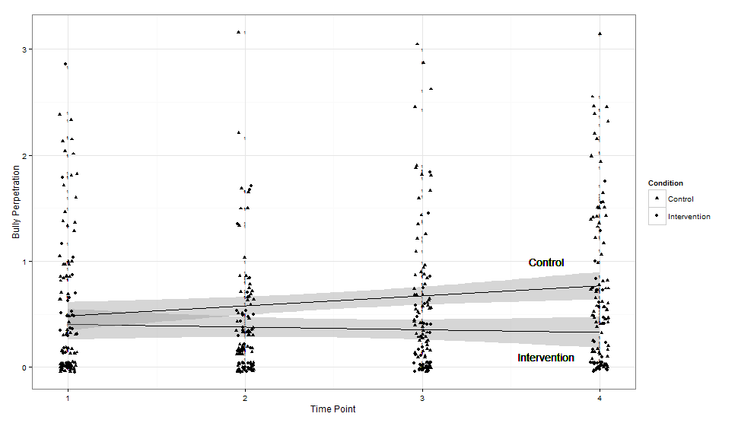
Students with Disabilities –
Bully Perpetration
(Espelage, Rose, & Polanin, 2015; 2016)

Slide 72
Cyberbullying Prevention
&
Intervention Efforts
Dorothy L. Espelage, Ph.D.
University of Florida
Jun Sun Hong, Ph.D.
Wayne State University
Canadian Journal of Psychiatry In Review Series (in press)
This research was supported by Centers for Disease Control & Prevention (#1U01/CE001677) to Dorothy Espelage (PI)

Slide 73
Cyberbullying Prevention Programs
Media Heroes (Chaux et al., 2016):
  German school-based, psychoeducational program in to raise students’ awareness about risks associated with technology use, to increase empathy and social responsibility, and to teach strategies to defend oneself and others from cyberbullying.
  Middle & high school
  10 90-minute sessions
  Theory of Planned Behavior - the program covers topics such as defining cyberbullying, a discussion of its negative impact, Internet safety tips, and opportunities to react appropriately using hypothetical scenarios
  Van Cleemput and colleagues’ (2014) meta-analysis indicated moderate reductions in cyberbullying perpetration (Hedges’ g = .19).

Slide 74
Cyberbullying Prevention Programs
Help-Assert Yourself-Humor-Avoid-Self-Talk-Own it (HAHASO; Salvatore & Weinholtz, 2006):
U.S. curriculum (age 10-12 years)
Five lessons to reduce bullying through increasing social skills.
Results yielded moderate levels of reductions in cyberbullying victimization (g = .32; Salvatore & Weinholtz, 2006).

Slide 75
Cyberbullying Prevention Programs
ConRed is a school-based program developed and evaluated in Spain (Ortega-Ruiz et al., 2012):
  Theory of Normative Behavior
  8 lessons delivered over 14 weeks for 11-19 years
  Three units cover the following topics using virtual scenarios: (1) Internet/social networks with a focus on privacy and control over accounts, (2) improving technical skills and prosocial online behavior, and (3) Internet addiction and cyberbullying.
  Results indicated modest reductions in cyberbullying (Hedges’ gs = .15, .06; Del Rey, Casas, & Ortega, 2012; Ortega et al., 2012).

Slide 76
Cyberbullying Prevention Programs
Meta-analysis by Van Cleemput and colleagues (2014) found most programs that targeted multiple forms of bullying.
Thus, many efficacious bullying prevention and intervention programs or approaches could be extended to include contents on cyberbullying.

Slide 77
Conclusions
Prevention programs yield reductions in bullying and victimization, and gender-based aggression.
Effects are strongest among elementary school children & diminish has youth mature.
Perceptions of staff matter – intolerance for sexual harassment is critical to reduce gender-based bullying and other forms of aggression.
Finally, to narrow the research-practice gap, the research must be RIGOROUS & RELEVANT

Slide 78
Leveraging technology & engaging youth to Prevent bullying, Violence, & Promote school violence

Slide 79
Trusting
Relationships
Interconnected
Protective
Factors
Interconnected
Risks
Bullying/Aggression
Student
Well-Being
Prosocial
Peers
Supportive
Schools

Slide 80
Youth-Driven Interventions
Student voices - not incorporated into school safety planning efforts in spite of research clearly showing that someone (most often peers) often has prior knowledge of a planned tragic event.
Students report a variety of reasons for not coming forward beforehand with that information (e.g., distrust, “snitching”).
To take advantage of this critical information, schools need to:
  a) involve students meaningfully in school safety planning efforts as co-equal partners along with school staff, administrators, and parents;
  b) have an efficient, easy mechanism for reporting such information confidentially, &
  c) assure students that their concern(s) will be promptly acted upon. In our view, such changes are likely to increase student investment and participation in keeping the school safe.
(Vincent, Espelage, Walker, et al., 2017, 2018)

Slide 81
Youth-Driven Interventions
Youth do feel that schools should work harder to establish a positive school climate.
Adults need to pay attention to emotional and physical safety.
Youth indicated that fairness & equity issues need to be addressed directly.
Research shows that students in schools with positive climates are more likely to report on the situations, individuals and events that endanger a school’s safety.
Such a climate can also improve student bonding and school engagement and serve as a protective factor against a host of negative outcomes over the long term within and beyond the school context.
(Vincent, Espelage, Walker, et al., 2017, 2018)

Slide 82
Barriers to Open Communication
Focus groups with students identified key student concerns that participants see as threats to their school’s safety & open communication with adults:
a) bullying, harassment and aggression,
b) weapons, drugs and alcohol on campus,
c) lack of supports for students with mental health issues,
d) overt discrimination among identified student groups sharing certain characteristics,
e) relational aggression and damaging reputation, and
f) inequity in all aspects of education.
(Espelage et al., 2018; Vincent, Espelage, Walker, et al., 2017, 2018)

Slide 83
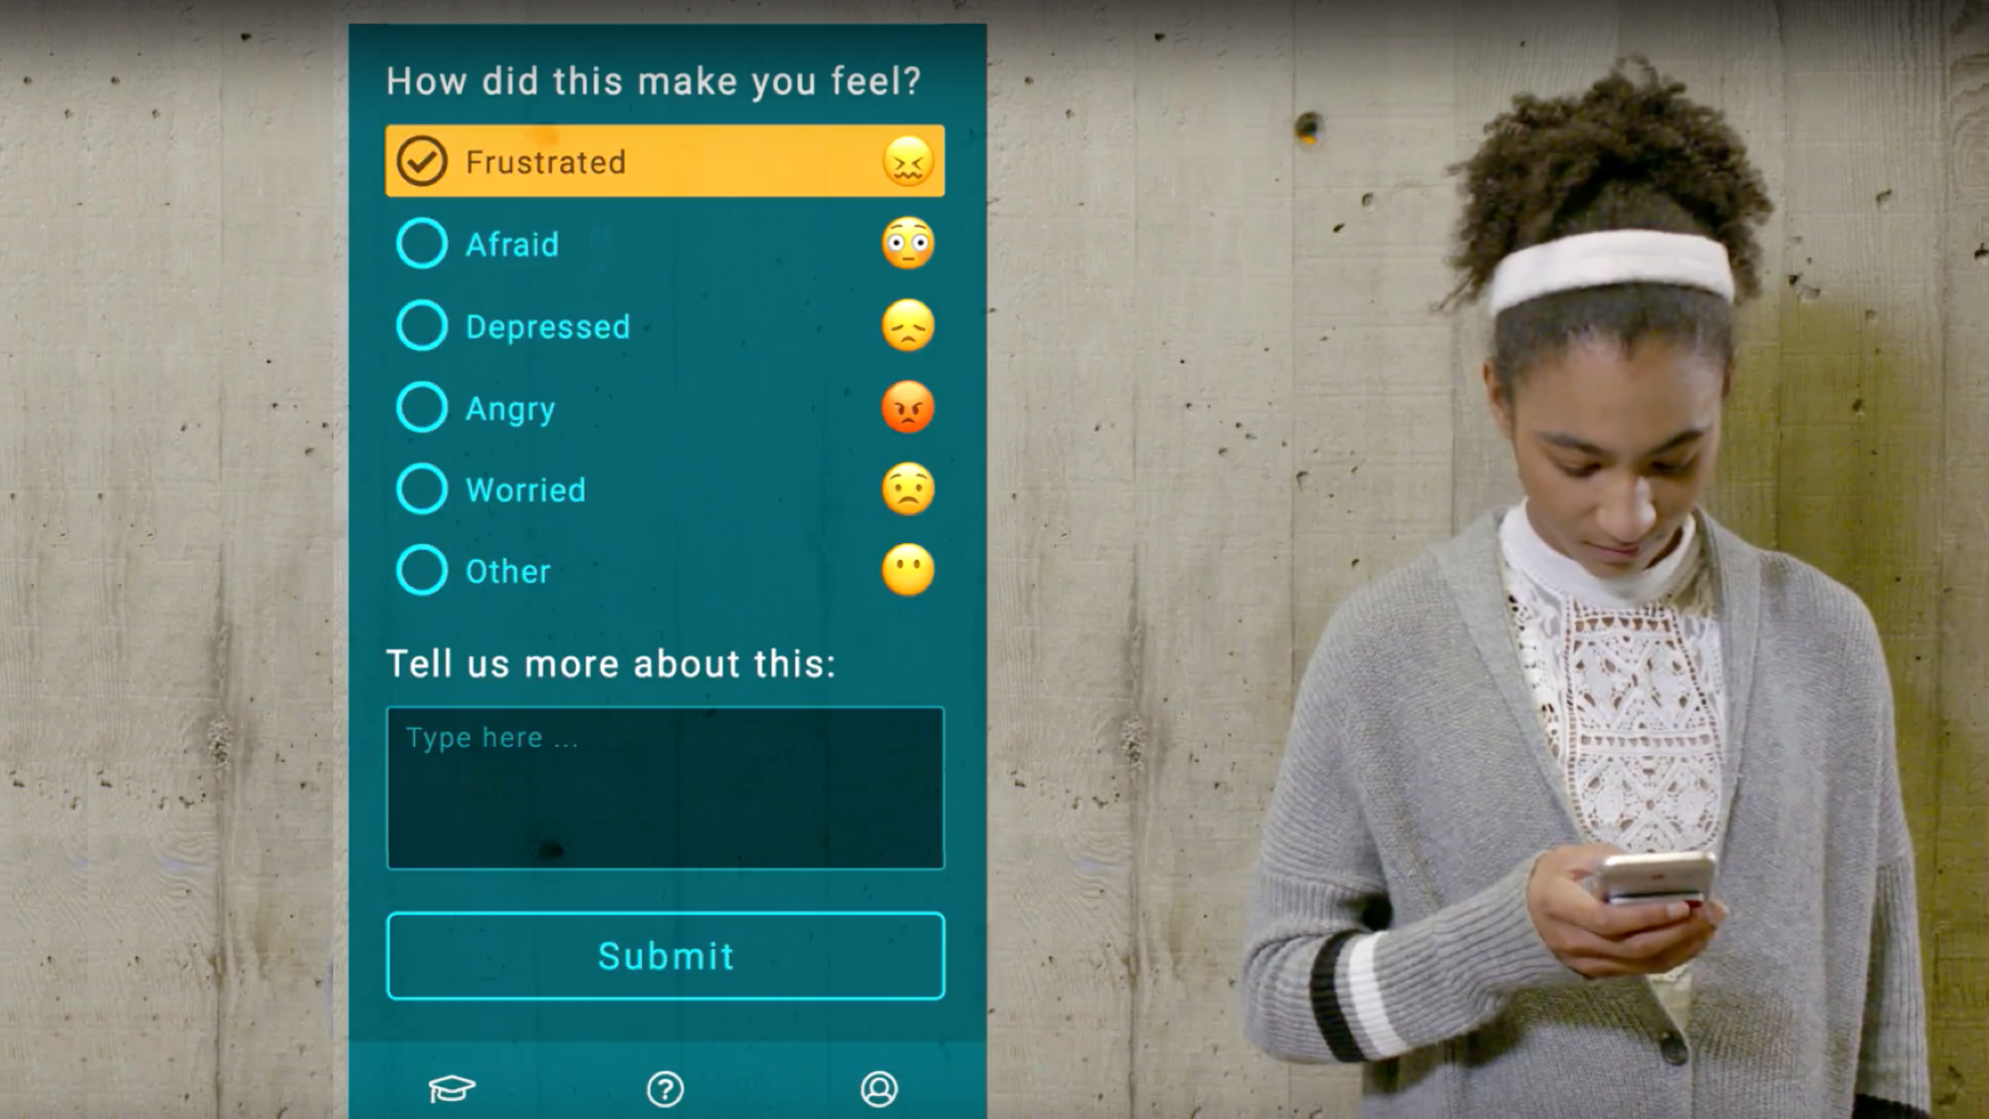


Slide 84
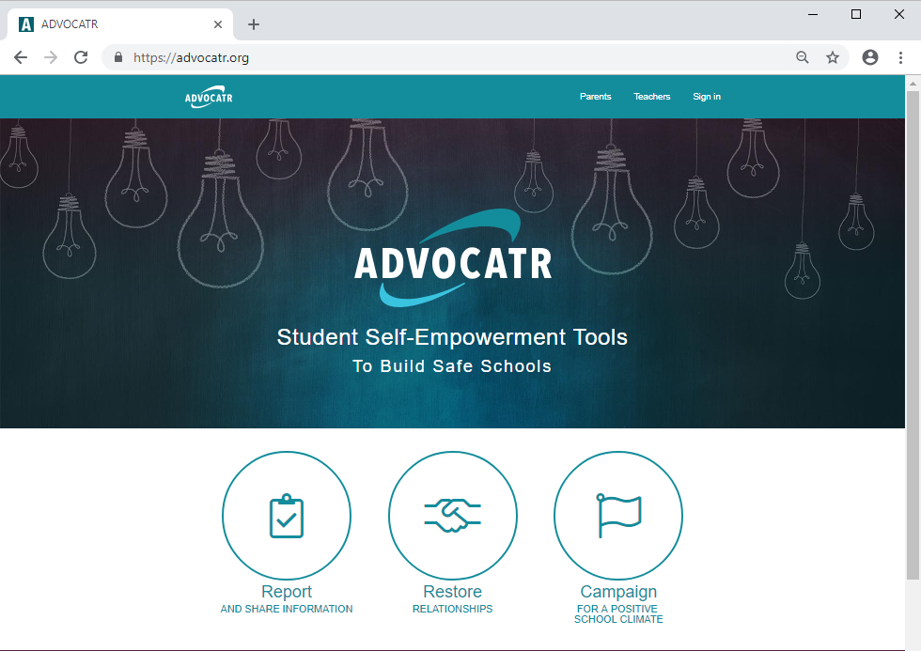
Advocatr
(Espelage et al., 2018; Vincent, Espelage, Walker, et al., 2017, 2018)

Slide 85
Advocatr
https://advocatr.org/

Slide 86
Advocatr
(Espelage et al., 2018; Vincent, Espelage, Walker, et al., 2017, 2018)

Slide 87
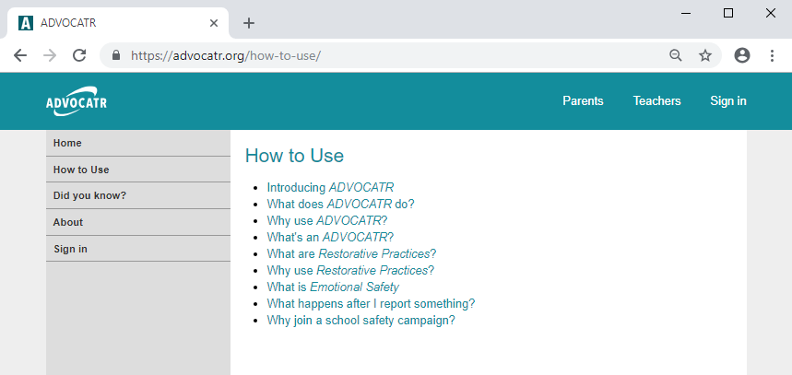
Instructional Video for Students: How to use Advocatr
Advocatr

Slide 88
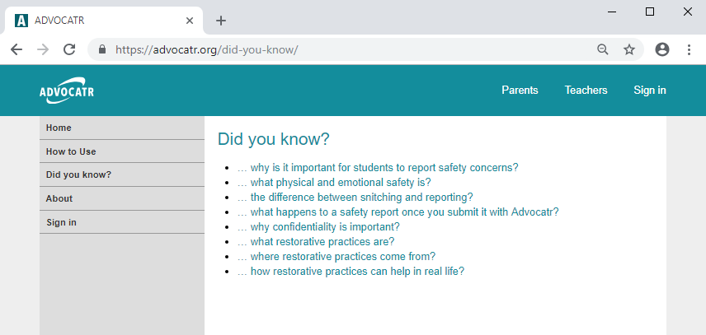
Information for students:
Did You Know…?
Advocatr

Slide 89
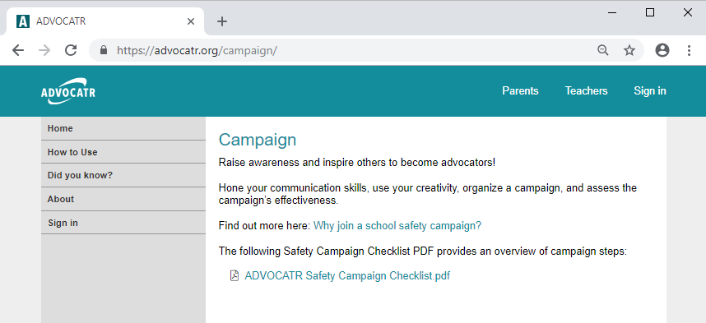
Student-led safety campaign
Advocatr

Slide 90
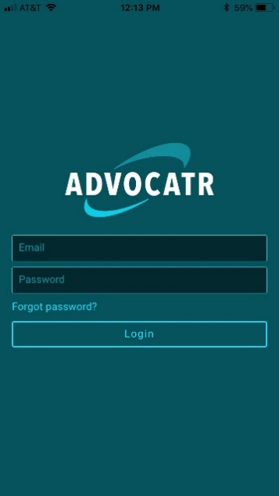
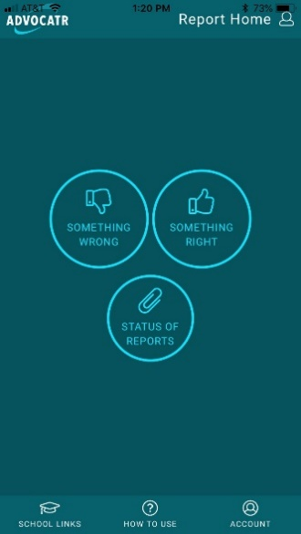
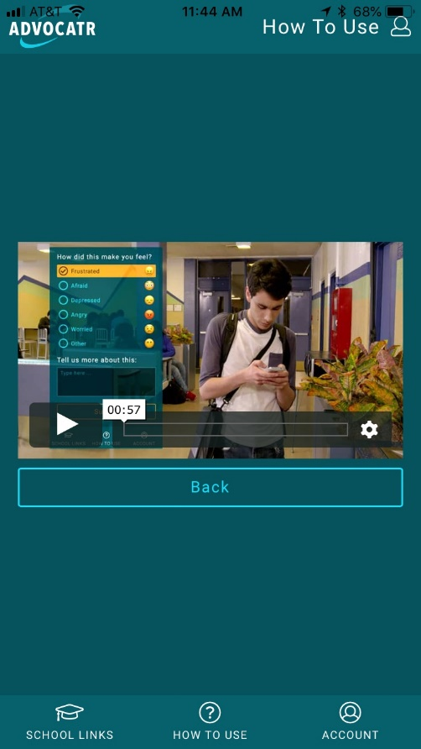
The Advocatr app
Advocatr

Slide 91

Study Design Cont.
Virtual Reality Bully Prevention Approach
Original curriculum: Stand Up: Virtual Reality to Activate Bystanders Against Bullying
  Informed by the empirical base (e.g., Polanin, Espelage, & Pigott, 2012), developed by an advisory board of youth aggression experts and professional GoogleVR screenwriters.
6 sessions delivered by a study staff member once per week
3 embedded VR experiences (created for Daydream) focusing on (1) the feelings of victims (2) the role of messages youth get about bullying in allowing it to continue and (3) being a change agent against bullying through small, realistic steps
Each lesson also included processing discussions and perspective taking activites
Ingram, K. M., Espelage, D.L., Valido, A.,
Heinhorst, J., & Joyce, M. (2019)

Slide 92

Implications
Virtual Reality Bully Prevention Approach
Results of small scale RCT (two classrooms) – significant increases in empathy & willingness to intervene
No impact on bullying behavior
Youth liked the 5-6 minute VR experiences, but found the curriculum less attractive
… This pilot justifies further exploration of incorporating VR to reduce youth violence
Ingram, K. M., Espelage, D.L., Valido, A.,
Heinhorst, J., & Joyce, M. (2019)

Slide 93
BullyDown: Social-emotional Learning App
Ybarra, Espelage, Valido, & Hong, 2019

Slide 94
The Impact of Sources of Strength, a Primary Prevention Youth Suicide Program, on Sexual Violence Perpetration among Colorado High School Students
Dorothy L. Espelage, Ph.D.
University of Florida
Peter Wyman, Ph.D.
University of Rochester
Tomei Kuehl, MPH
Colorado Dept. of Public Health
Todd Little, Ph.D.
Texas Tech University
This research was supported by Centers for Disease Control & Prevention (#1U01CE002841) to Dorothy Espelage (PI)

Slide 95

Sources of Strengths
https://www.youtube.com/watch?v=RanDdvzHkjA

Slide 96

Sources of Strengths
Sources of Strength employs a radically strength--based approach to prevention. in schools – PEER LEADERS.
Sources of Strength focuses on developing protective factors, using a model that is innovative, interactive, and radically strength-based.
Using an active learning model, incorporating art, storytelling, small group sharing and games.
Sources of Strength explores the eight protective factors, depicted in the wheel of strength, to develop resilient individuals and communities.

Slide 97


EVIDENCE-BASED
Program outcomes have shown:
Increase in connectedness to adults
Increase in school engagement
Increase in likelihood to refer a suicidal friend to an adult
Increase in positive perceptions of adult support
Increased acceptability of seeking help
Largest increases amongst students with a history of suicidal ideation
Wyman,, P.. et al.. (2010). An outcome evaluation of the Sources of Strength suicide prevention program delivered by adolescent peer leaders in high schools.. American Journal of Public Health, Vol. 100: 1653--1661.

Slide 98

Trauma-Informed Approaches to Violence Prevention

Slide 99

Restorative Problem Solving
Although further research is needed, there are very promising findings endorsing the use of Restorative Problem Solving in our schools (Fronius et al., 2016).

Slide 100
Enhancing School Safety Officers’ Effectiveness through Online Professional Development training
Dr. Dorothy Espelage, Ph.D. Co-PI Dr. Philip Poekert Co- PI Dr. Walter Leite, Ph.D.
University of Florida University of Florida University of Florida
Department of Psychology Lastinger Center for Learning walter.leite@coeufl.edu
espelage@ufl.edu poekert@coe.ufl.edu
Funding Source: National Institute of Justice (January 2018 – December 2021)

Slide 101
School Resource Officers (SROs) = Police Officers
SROs receive extensive training to address physical safety concerns and crime.
Enhancing existing extensive training with training in competencies specific to child development and youth behavioral and mental health has potential to pave the way for nation-wide progress in SRO professional development.

Slide 102
CONCLUSIONS
Addressing bullying and school violence and promoting a positive school climate requires a multi-pronged approach.
Simply ”hardening” of our schools has the risk of creating greater inequities, anxiety, and isolation of students, teachers, and families.
Youth need to be authentically engaged in efforts to promote school safety, social justice, equity, and inclusion.
All adults who interact with youth can benefit from training in trauma-informed approaches, restorative approaches, social-emotional learning, & cultural competence.

