Slide 1
Challenge2Change
Engaging High School Youth in Racial/Ethnic Development and Intergroup Communication
Annahita Ball, PhD, MSW
Gregory Pigeon, MS, MSEd
Susan Paul-Saladino, MSEd
Candra Skrzypek, LMSW
Notes:
ANNA

Slide 2
Objectives
Describe and explain intergroup dialogue pedagogy and how it informed our development of Challenge2Change.
Identify specific goals, activities, and structures of intergroup dialogue programs, using Challenge2Change as a model.
Convey lessons learned and best practices for implementing programs similar to Challenge2Change.
Discuss next steps and future directions for practice, teaching, and research.
Notes:
ANNA

Slide 3
Background
Increasing diversity in the United States requires greater inter-cultural knowledge and understanding
Today, much of this diversity is felt in the suburbs of major cities (Orfield & Luce, 2012)
Diverse schools must be physically and emotionally safe for all students to learn (National School Climate Center, 2013)
Adolescents are developmentally primed for intergroup communication and dialogue (i.e., focus on identity development, peer relationships, abstract thinking)
Notes:
ANNA
The majority of children born in the U.S. are non-White (US Census Bureau, 2012)
Diverse communities are defined as areas where non-white residents represent 20-60 percent of the population

Slide 4
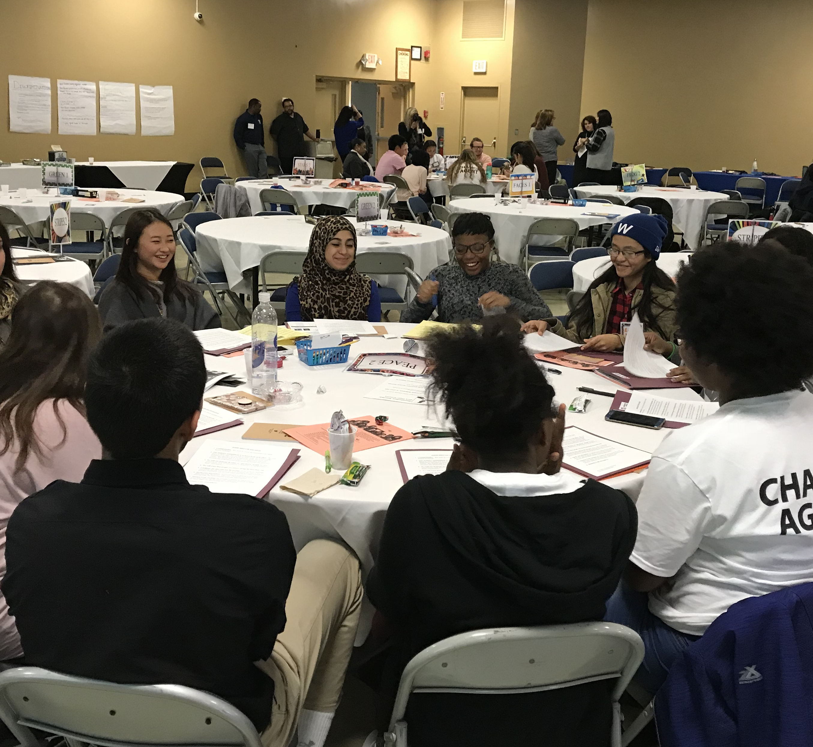
Intergroup Dialogue
Face-to-face facilitated dialogue between groups of two or more social identity groups with direction toward social action
Encourage direct exchange about difficult topics related to social identity to examine dynamics of privilege and oppression
Cultivate participants’ dispositions and skills for developing and maintaining relationships across difference and for creating change that promotes equity and social justice
(Zúñiga, 2003)
Notes:
ANNA
Social identity group: group affiliation based on common status or history in society resulting from social constructed group affiliation

Slide 5
Stages of Dialogue
Creating an Environment for Dialogue
Situating the Dialogue: Learning about Differences and Commonalities of Experience
Exploring Conflicts and Multiple Perspectives: Dialoguing about “Hot” Topics
Moving from Dialogue to Action: Action Planning and Alliance Building
(Zúñiga, 2003)
Notes:
CANDRA

Slide 6
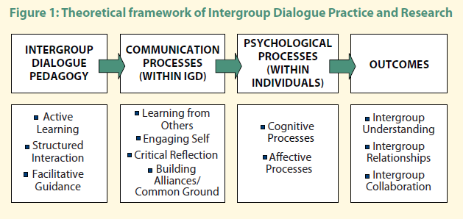
Nagda, B. A., Gurin, P., Sorensen, N., & Zuñiga, X. (2009). Evaluating intergroup dialogue: Engaging diversity for personal and social responsibility. Diversity & Democracy, 12(1), 4-6.
Notes:
CANDRA

Slide 7

Activity: Debate Discussion Dialogue
Notes:
CANDRA
Handouts: Comparing Debate, Discussion, and Dialogue

Slide 8
The Challenge2Change Story
Existing Infrastructure:
Covenant in Action Club
Inspiration:
Gateway2Change
Roc2Change
Challenge2Change Club
UB Partnership
Emphasis on personal growth, leadership, and citizenship
Changing student needs
Professional partnership
Attendance in Rochester
Notes:
GREG & SUE

Slide 9
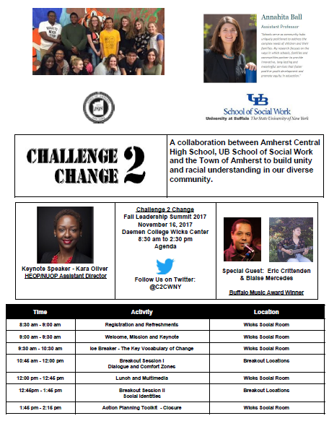
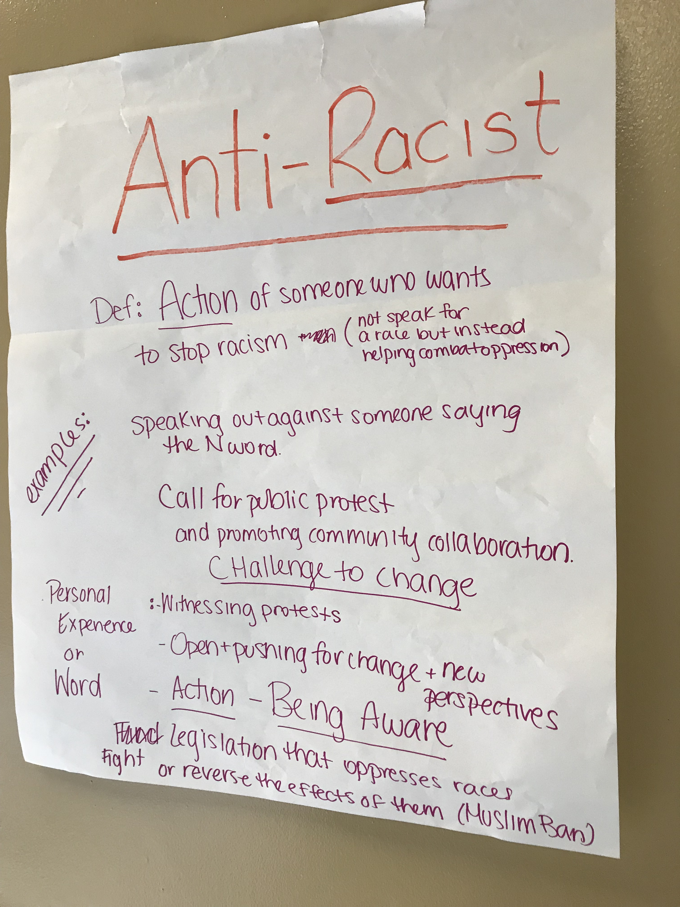
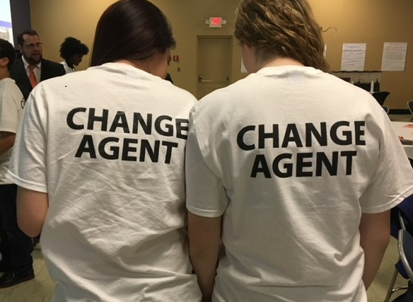
Student Leadership Summits
Notes:
GREG & SUE
Goal of Summit: To introduce students to fundamental terms and concepts, begin to explore their own and others’ social identities, create community and belonging and motivate for social action
Explain Agenda

Slide 10
Breakout Sessions: Dialogues & Deeper Dives
Activity | Purpose
Frozen Yogurt vs. Ice Cream | Understand the differences between dialogues, discussions, and debates
Comfort Zone, Learning Edge, Danger Zone | Identify one’s own comfort zones, learning edges, and danger zones to build self-awareness and begin the growth process
Social Identity Wheel & Partner Share | Understand one’s own and others’ social identities; reflect on the ways in which we are socialized to understand social identities
Notes:
CANDRA

Slide 11
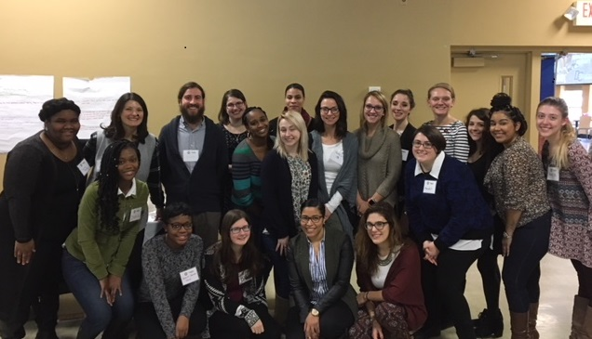
UB Social Work Pre-Service Training
1-credit and 3-credit courses:
Dialogue Facilitation Skills
Immersive Field Experience
MSW competencies:
Knowledge and awareness of one’s own and others’ social identities
Small group facilitation skills
Notes:
ANNA

Slide 12
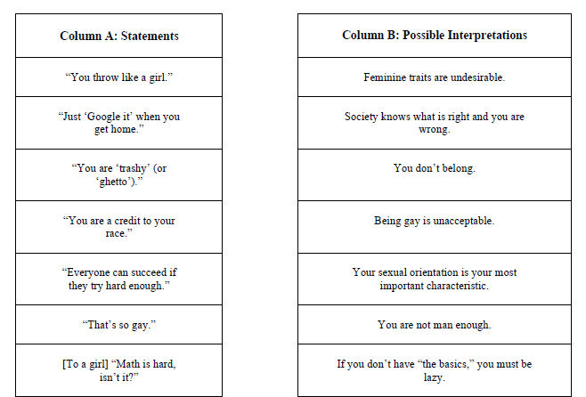
Faculty Development
Faculty meeting push-in
Topic: Microaggressions
Small Group Activity
Student-Facilitated Discussion
Notes:
GREG & SUE

Slide 13
Lessons Learned and Best Practices (Q&A)
Students need a forum and safe space with adult guidance.
Adults have to be prepared to lead.
Partnerships are critical. Students need to have skills and norms before entering challenging and courageous conversations.
We have to follow up. Students need a forum and infrastructure to carry this work beyond the initial summits.
Notes:
ALL (Open to audience questions if they come up)

Slide 14
Next Steps
Dialogue Immersion
Moving toward Social Action
Program Evaluation
Notes:
ANNA

Slide 15
Dialogue Immersion
3 credit course: MSW students facilitate sustained dialogues
(7 weeks)
Incorporate the last two stages of dialogues
Exploring conflict and multiple perspectives
Moving from dialogue to action
Build MSW students’ understanding of IGD pedagogy and enhance practice skills
Notes:
ANNA

Slide 16
Social Action
Shifting to “hot” issues and then social action
Student-driven action plans
Facilitated by MSW students
Leverage existing resources and infrastructure in the schools
Clubs
Social Media
Partnerships with other groups
Community Forums
Fundraisers
Power Analysis and Mapping
School Board Presentation
Social Awareness Events
Op-Eds
Parades
Spirit (“Issue”) Days
Notes:
ANNA

Slide 17
Program Evaluation
Pre/Post Evaluation of 2018 Summit
Survey measures:
Social identity awareness
Critical social awareness
Intergroup relations
Intergroup empathy
Critical consciousness
Motivation to take action
Comparison Groups (Waitlist Control)
Observations of Intergroup Relations
School Climate Outcomes
Teacher and Family Perceptions
Notes:
ANNA

Slide 18
With special thanks to…
Partnering school districts: Williamsville, KenTon, Sweet Home
Roc2Change
The Program on Intergroup Relations at University of Michigan
For more information, contact Annahita Ball at annahita@buffalo.edu,
Notes:
ANNA
Q&A - ALL

