Slide 1
Exploring Aggression and Hostility in Early Childhood
Stephanie Godleski, Ph.D.
Department of Psychology
Rochester Institute of Technology

Slide 2
Outline
Aggression
Forms of aggression
Developmental pathways and outcomes
Risk Factors
Hostility and emotion regulation
Caregiver influences
Assessment
Implications

Slide 3
My research
Overall, understanding the relation between maladaptive thought patterns and the use of aggressive behavior
How do we best measure and analyze these constructs, especially in early childhood?
The underlying processes that lead to maladaptive thought patterns and aggression
In particular:
The role of parents
The context of risk and parental substance use
Prenatal exposure to substances
The outcomes associated with these risk factors and thoughts and behaviors

Slide 4
Aggression
Forms of Aggression
Physical: Intent to hurt another individual using physical force or the threat of physical harm (Dodge et al., 2006)
Examples: Hitting, taking objects, kicking
Relational: The removal or the threat of the removal of relationships as the means of harm (Crick & Grotpeter, 1995)
Examples: Gossip, silent treatment, exclusion
Verbal Aggression: Harming through verbal assault or taunting
Examples: Teasing and name calling

Slide 5
Aggression is considered to be a core factor in adverse health outcomes for children (Eisner & Malti, 2015)
Engaging in early relational and physical aggression is associated with maladjustment, such as peer rejection and engaging in less prosocial behavior
Later in development aggression is associated with mental health outcomes (e.g., ADHD, depression, eating disorders), as well as alcohol and drug abuse, school dropout, and violence and delinquency
(Birch & Ladd, 1998; Broidy et al., 2003; Brook, Whiteman, Finch, & Cohen, 1996; Crick, Casas, & Mosher, 1997; Grotpeter & Crick, 1996; Crick, Ostrov, & Werner, 2006; Crick, Ostrov, Burr, Cullerton-Sen, Jansen-Yeh, & Ralston, 2006; Heilbron & Prinstein, 2008; Kokko, Tremblay, Lacourse, Nagin, & Vitaro, 2006; Murray-Close, Ostrov, & Crick, 2007; Prinstein, Boergers, & Vernberg, 2001; Storch, Bagner, Geffken, & Baumeister, 2004; Werner & Crick, 1999; Zalecki & Hinshaw, 2004)

Slide 6
Importance of Early Childhood
Infancy and early childhood (i.e., ages 3 to 5) are important times for the development of several key cognitive and social developmental tasks:
Learning to intentionally focus and pay attention to their environments
Increasing language and memory capabilities
Changes in social perspective
Developing the ability to consciously self-regulate their own thoughts, behaviors, and emotions
Greater experiences with peer relationships as enter toddlerhood and preschool

Slide 7
Early Aggression and Hostility

Slide 8
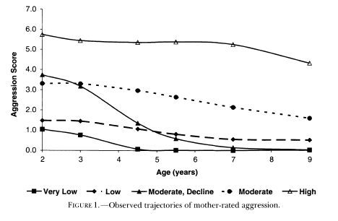
Developmental Changes in Physical Aggression
From the Monographs of the Society for Research in Child Development, 2004 (4)

Slide 9
Persisting through childhood and adolescence
From Tremblay and Cote (2009)

Slide 10
Early Aggression and Anger
High levels of anger and use of force against others as early as 6 months of age predicts aggression at later developmental periods (Hay et al., 2014)
By 12 to 14 months of age, physical aggression is apparent and by 17 months of age, persistently high trajectories of aggression can already be established (Alink et al., 2006; Eisner & Malti, 2015; Tremblay et al., 1999; Tremblay & Cote, 2009)

Slide 11
Early Indicators
Tendency to be contentious or to be conflictual with others when interacting (Hay et al., 2014)
Not considered aggression when in infancy, because of lack of intent to harm
Can be a precursor to later intentional aggression
Hits out at people
Angry moods
Bites
Temper tantrums
Grabbing toys out of other children’s hands (toddlerhood)
Hitting or kicking to get toys (toddlerhood)
However, aggressive behavior is potentially normative in earlier developmental periods (Dodge, Coie, & Lynam, 2006)

Slide 12
What puts children at risk for aggression?

Slide 13
Information Processing
Hostile Attribution Biases (HAB): Over-attributing hostile intent to peers’ behaviors
Occurs even in situations where hostile attribution is not warranted (Dodge, 1980; Dodge & Frame, 1982; Dodge, Murphy, & Buchsbaum, 1984)
Indicative of reactively or impulsively responding aggressively (Crick & Dodge, 1996; Dodge & Coie, 1987; Schwartz et al., 1998)
Predictive of the development and maintenance of aggression

Slide 14
Assessing Early Hostile Attribution Biases
Assessment of Intent Attributions (Crick, 1995)
Vignettes of socially ambiguous relational provocation situations (4 vignettes; e.g., discovering that a friend has not invited you to his or her birthday party)

Slide 15
Emotion and Emotion Regulation
Dysregulation of emotion, either over- or under-regulation
Reactivity, such as distress at limitations (i.e., reactions to potentially frustrating situations)
Emotional processes can play an important role in social decisions (Lemerise & Arsenio, 2000)
Interventions often target emotion understanding and awareness (e.g., Roberton et al., 2012) and interpretation of social cues (e.g., Friend to Friend; Leff et al., 2015, 2016)

Slide 16
Caregiver Influences
Infancy and early childhood may be a particularly critical time to investigate the influences of parents
Risk for persistent high levels of aggression when exposed to early coercive parenting, parental depression, and other parent risk factors in the perinatal period → impacting gene expression (Tremblay & Cote, 2009)
Low contact (i.e., carrying, holding) could impact neural development and gene expression such that the risk for stress reactivity is increased (Moore et al.,2017)

Slide 17
Caregiver Influences
Perceptions and feelings regarding social situations develop gradually and are impacted by social interactions (Crick & Ladd, 1993; Rubin et al., 2006)
Social Learning Theory: Children learn through socialization by their caregivers, both indirectly through modeling and more directly through parenting practices (Akers, 1977; Bandura, 1969; 1977)
Modeling of hostile attributions and aggression (e.g., Dodge, 2006)
Harsh discipline practices and negative parent-child interactions → poor behavioral outcomes for children, such as dysregulation, aggression, and child hostile intent attributions (e.g., Dodge, Coie, & Lynam, 2006; Loeber & Hay, 1997; Eiden, Schuetze, & Coles, 2011; Heidgerken et al., 2004; Nix et al., 1999)

Slide 18
Sample
Thoughts and Behaviors Project
Child Participants
121 children (63 girls)
Average Age: 51.21 months (SD = 9.35, Range = 35.25 – 72.15)
Parent Participants
Primarily Mothers (N = 118)
Majority currently married (90%)
European American (81%)
Total household income in the last year of $55,000 – 100,000 or above (75%)
Four year degree (35.7%) or a graduate or professional degree (39.5%)

Slide 19
Parent Modeling and Parenting → Child Hostile Attribution Biases
Parent Relational Aggression
Child Hostile
Attribution Biases
Parenting/Discipline
Parent Hostile
Attribution Biases

Slide 20
Parent Modeling and Parenting → Child Hostile Attribution Biases
Parent Relational Aggression
-.15
.40
Psychological
Control
.02
Child Hostile
Attribution Biases
-.22
Parent Hostile
Attribution Biases
.20
Parent Hostile
Attribution Biases
Child Hostile
Attribution Biases

Slide 21
Caregiver Influences
Association has been demonstrated between parent alcohol use and:
Peer bullying (e.g., Eiden et al., 2010)
Aggression (e.g., Edwards et al., 2006)
Externalizing behavior problems, behavioral undercontrol, and behavior problems (Eiden et al., 2007; Loukas et al., 2003)
Prenatal exposure to cigarettes → child aggression
Substance problems associated with negative parenting practices, such as poor monitoring (e.g., Chassin et al., 2004) and lower positive involvement (e.g., Eiden et al, 2004)
Importance of attachment, the quality of parent-child relationship, (Edwards et al., 2006; Eiden et al., 2004) and warm, sensitive, supportive parenting (Eiden et al., 2006; 2007)

Slide 22
Facilitating Emotion Regulation
Warmth and sensitivity are key, particularly early in development
High affective attunement and warmth/sensitivity in the first years of life may be particularly protective and predict lower levels of dysregulation and aggression (Raby, Roisman, Fraley, & Simpson, 2015)
Parents may experience other factors that could interfere with their ability to engage in these positive parenting behaviors and modeling of appropriate behavioral and emotional responses, such as psychopathology, substance use, and stress (e.g., Eiden et al., 2011)

Slide 23
Sample
Growing Up Healthy Study (PI: Dr. Rina Eiden, NIDA R01 DA019632)
Sample consists of over 200 mother-infant dyads recruited prenatally
Mothers ranged in age from 18 to 39
Primarily low-income, minority women with high school or below education, with 1-2 children

Slide 24
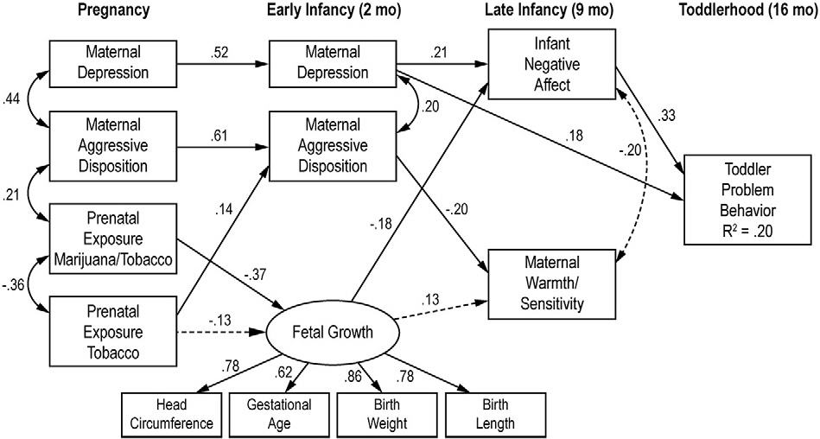
Structural Equations Model for PTE and Toddler Problem Behavior
Godleski, Eiden, et al. (2016) NTT

Slide 25
Early Exposure to Tobacco and Aggression
Average number of cigarettes smoked per day during pregnancy and postnatal exposure to nicotine were associated with child-report of relational and physical aggression in Kindergarten even when controlling for child gender and maternal characteristics
High levels of both prenatal and postnatal exposure was associated with the highest levels of aggression
Godleski & Eiden, SRNT, 2018

Slide 26
Assessing Responses to Peer Behavior
Work to understand the direct role of parents in the development of social cognitive biases
Collecting qualitative data on parenting specific to ambiguous social situations
Providing a scenario that is ambiguous, then asking:
How would you explain what happened to your child?
Parent provides response either written or as interview response

Slide 27
First Wave of Coding
Benign
Hostile
“Accidents happen. You spill things too and that’s why mommies do so much laundry.”
“Oh, I’m sorry you fell down. I’m sure it was an accident that they bumped in to you. I bet she was excited to go outside.”
“They weren’t being very nice and maybe you shouldn’t be friends with them after all. “
“I would tell him that the kids were being not very nice and that he doesn't need friends like that anyways. Also that he should never act like that and we could have more fun without them.”

Slide 28
Comparing Responses
Mothers who were more hostile and aggressive were 3 times more likely to interpret the situations as hostile
Mothers who were of lower socio-economic status, lower education level, and younger were 1.5 times more likely to interpret the situations as hostile

Slide 29
Responding to Children’s Negative Emotion
Children with parents who experience distress and use harsh coping strategies in response to their children’s negative emotion are more likely to have higher levels of negative emotions and are less socially competent (Fabes et al., 2001)
Maternal warmth and responsiveness to child distress are associated with greater levels of self-regulation and internalization of the rules (von Suchodoletz et al., 2011)

Slide 30
Responding to Children’s Negative Emotion
Maternal prosocial behavior and responding to child negative emotion with problem-focused coping → child report of prosocial behavior in Kindergarten (Kneuer, Godleski, & Eiden, 2018, SPR)
Supporting emotional expression and emotion-focused coping → less child dysregulation and externalizing behavior (Fleming, Godleski, & Eiden, 2017, SRNT)

Slide 31
Summary and Implications
Promoting emotion regulation
Supportive responses to children's distress and negative emotion
Modeling appropriate behavior and regulation strategies
Facilitating positive parenting behavior
Screening and treatment for substance use and psychopathology
Supporting warmth, sensitivity, and consistency
Implications of early indicators of aggression and hostility
Child emotion regulation and social cognition
Motivation

Slide 32

School and Peer Based Interventions

Slide 33


Thanks!
Questions?
saggsh@rit.edu
Acknowledgements: Dr. Jamie Ostrov, Dr. Rina Das Eiden, Dr. Rebecca Houston, Dr. Kenneth Leonard, Dr. Craig Colder, Dr. Julie Bowker, Dr. Cory Crane, Dr. Lora Park, Meghan Casey, Shannon Shisler, Dr. Kim Kamper, Research Institute on Addictions (NIAAA T32 Fellowship), University at Buffalo Mark Diamond Research Fund, and all of the Research Assistants in the UB and RIT Social Development Laboratories and in the Growing Up Healthy Study as all of the participating families

